Slide 1
Executable network models of integrated multi-omics data
Mukta G. Palshikar¹, Xiaojun Min², Alexander Crystal², Jiayue Meng, Shannon Hilchey³, Martin Zand^{3,4}, Juilee Thakar^{1,4,5,6,7*}
¹ Biophysics, Structural, and Computational Biology Program, University of Rochester School of Medicine and Dentistry, Rochester, USA. ²University of Rochester College of Arts, Sciences and Engineering, Rochester, USA. ³Division of Nephrology, University of Rochester School of Medicine and Dentistry, Rochester, USA. ⁴University of Rochester Clinical & Translational Science Institute, Rochester, USA. ⁵Department of Biostatistics and Computational Biology, University of Rochester School of Medicine and Dentistry, Rochester, USA. ⁶Department of Microbiology and Immunology, University of Rochester School of Medicine and Dentistry, Rochester, USA. ⁷Department of Biomedical Genetics, University of Rochester School of Medicine and Dentistry, Rochester, USA.

Slide 2
Outline of manuscript
Multi-omics network modeling and pathway enrichment analysis with mBONITA
Outline methods for data integration, rule inference, node modulation scores, and pathway analysis (Figure 1)
mBONITA identifies mechanisms of hypoxia-mediated chemotaxis in RAMOS B cells (pathway analysis with mBONITA)
Supplement – transcriptomics data analysis (Supplementary Figure 1)
Correlation between omics datasets (Figure 2A and B)
Pathway analysis with mBONITA on multiomics data (Figure 2C )
Pathway-based prioritization of genes in a signaling network with mBONITA
Node importance score: show a case study of a LSP1/HIF1A-centric signaling network
Benchmarking of mBONITA
Rule inference: Supplement - show that mBONITA identifies a smaller rule set from combined omics data than from individual datasets
Pathway analysis:
mBONITA identifies more significant pathways than:
PaintOmics:
LeapR:
ActivePathways:
CAMERA:
BONITA (TBD)
Show pathways in supplement figures & tables
mBONITA identifies different node importance scores from BONITA:
Supplement – low correlations between node importance score from single omics and multi-omics data (ie, a comparison to mBONITA)

Slide 3
Main figures
Figure 1: moBONITA integrates information from multiple omics datasets to learn a consensus set of logic rules for simulation and perturbation of prior knowledge networks
Figure 2: mBONITA identifies mechanisms of hypoxia-mediated chemotaxis from a multi-omics dataset from RAMOS B cells grown under three conditions (A) 1505 genes were profiled in all three omics datasets (median log2-abundance > 0) (B) The multi-omics datasets showed low inter-dataset correlations. Distinct experimental conditions are indicated by colors and shapes as shown in the legend. (C ) KEGG pathways identified by mBONITA as significantly dyresgulated in the three contrasts. Pathways are defined as differentially regulated if the Benjamini-Hochberg corrected p-value < 0.05.
Figure 3: Pathway-based prioritization of genes in a signaling network with mBONITA. Node importance score: show a case study of a LSP1/HIF1A-centric signaling network (TO BE DONE). (A) Network figure (B) Heatmap of node modulation scores. This is a placeholder/draft figure showing node modulation scores for each dataset/contrast combination for the B cell receptor signaling network. NB – this is just IS * RA, need to multiply by std.dev as well.
Figure 4: Benchmarking of mBONITA. Numbers of differentially regulated KEGG pathways identified from combination multi-omics data by tested methods in three contrasts (A) 19%O2,CyA- vs 1%O2,CyA- (B) 1%O2,CyA+ vs 1%O2,CyA- (C ) 19%O2,CyA- vs 1%O2,CyA+ (D). Pathways known to be involved in the hypoxia-mediated response to CyA, Only pathways identified as significant from a combined dataset by at least one method are shown. Pathways are defined as differentially regulated if the Benjamini-Hochberg corrected p-value < 0.05.

Slide 4
Supplementary Materials
Supplementary Table 1 Experimental conditions in the three datasets from RAMOS B cells. Conditions that are in all datasets are highlighted in red.
Suppplementary Figure 1: Transcriptomics analysis of RAMOS B cells grown under three conditions. (A) Numbers of differentially expressed genes identified by DESeq2 in all three contrasts (absolute log2-fold change > 0.5 and Bonferroni-adjusted p-value < 0.05) (B) z-scored RPM values of DE genes identified in all/any contrast. Experimental conditions are indicated by colors as shown in the legend. (C ) Over-representation analysis of DE genes in all three contrasts (unadjusted p-value < 0.05). Complete tables of DE genes and over-represented pathways may be found in the Supplementary Data.
Supplementary Table 2: KEGG Pathways involved in the HIF1A-mediated response of B cells to hypoxia and CyA
Supplementary Figure 2: Rule inference from all three datasets – (A) Rule set sizes, (B) Importance scores (Spearman correlations between 0.5 and 0.8, p << 0.01). See Supplementary Table 3 for all correlation coefficients.
Supplementary Table 3: Spearman correlation between importance scores
Supplementary Figure 3: Comparison of mBONITA-PA to BONITA-PA Numbers of differentially regulated pathways identified from combination multi-omics data by mBONITA in three contrasts (A) 19%O2,CyA- vs 1%O2,CyA- (B) 1%O2,CyA+ vs 1%O2,CyA- (C ) 19%O2,CyA- vs 1%O2,CyA+. Pathways are defined as differentially regulated if the Benjamini-Hochberg corrected p-value < 0.05.
Supplementary Figure 4: Pathway analysis with Bonita. All p-values are Bonferroni-corrected and are < 0.01. The top 10 pathways with the lowest p-values are shown. A complete table of significantly dysregulated pathways may be found in the Supplementary Data. (a) Proteomics (top 10 pathways with the lowest p-values are shown) (b) Phosphoproteomics (top 10 pathways with the lowest p-values are shown) (c) Transcriptomics (top 4 pathways with the lowest p-values are shown) (d) TO BE ADDED. Multiomics network. Contrasts are color-coded as shown in the legend.
Supplementary File 1: mBONITA-PA results Excel workbook - pvalues_concatenated_20220816
Supplementary File 2: PaintOmics results (paintomics_allResults.csv)
Supplementary File 3: leapR results (leapR_allResults.csv)
Supplementary File 4: CAMERA results (camera_allResults.csv)
Supplementary File 5: ActivePathways results (activePathways_allResults.csv)
Supplementary File 6: BONITA results
Supplementary Figure 5: paintOMICS results
Supplementary Figure 6: leapR results
Supplementary Figure 7: ActivePathways
Supplementary Figure 8: CAMERA + Fisher results

Slide 5
Main figures and tables

Slide 6
GOAL
INPUT DATA
DATA INTEGRATION
OUTPUT
Gene expression
Learned Boolean Rules
Combine multi-omics datasets into a single interpretable dynamic model
Protein abundance
Combination into single training dataset
Node modulation scores
Protein modifications
Ranked dysregulated pathways
Figure 1 moBONITA integrates information from multiple omics datasets to (A) learn a consensus set of logic rules for a prior knowledge networks (PKNs) (B) simulate and perturb PKNs in silico (C ) calculate condition-specific node modulation scores, and (D) perform pathway analysis.

Slide 7
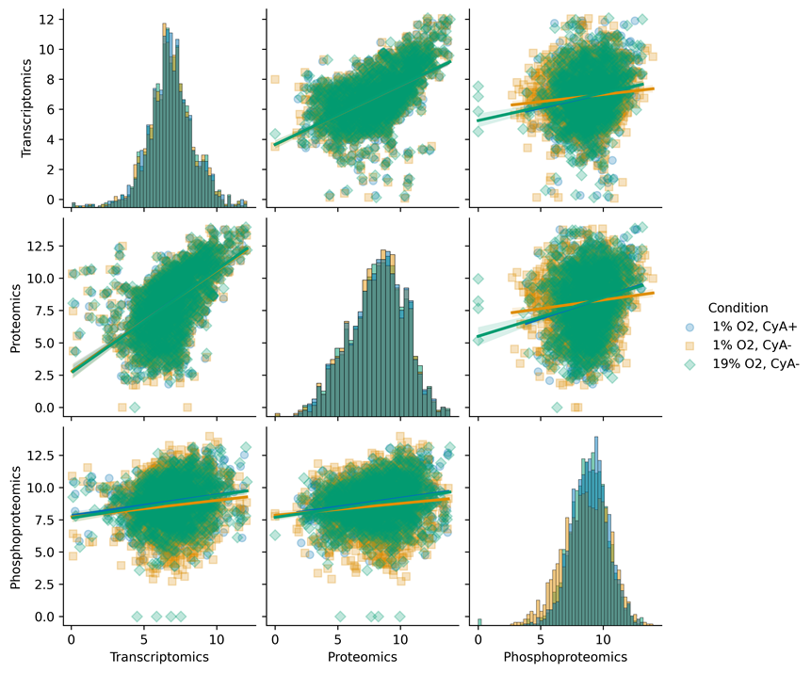
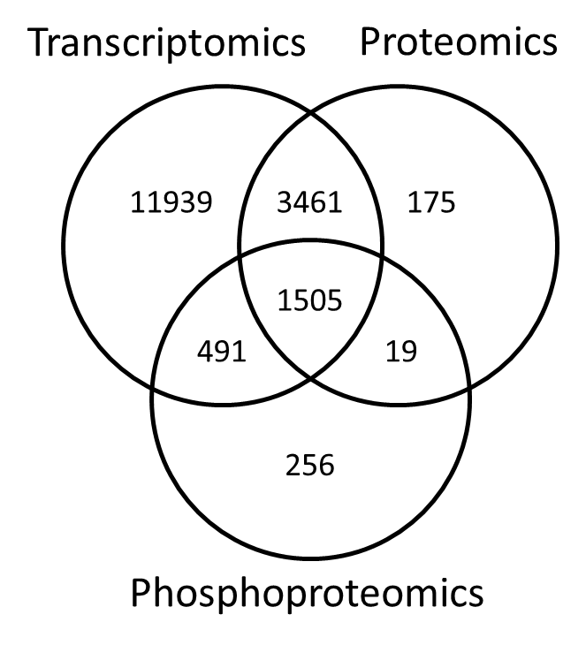
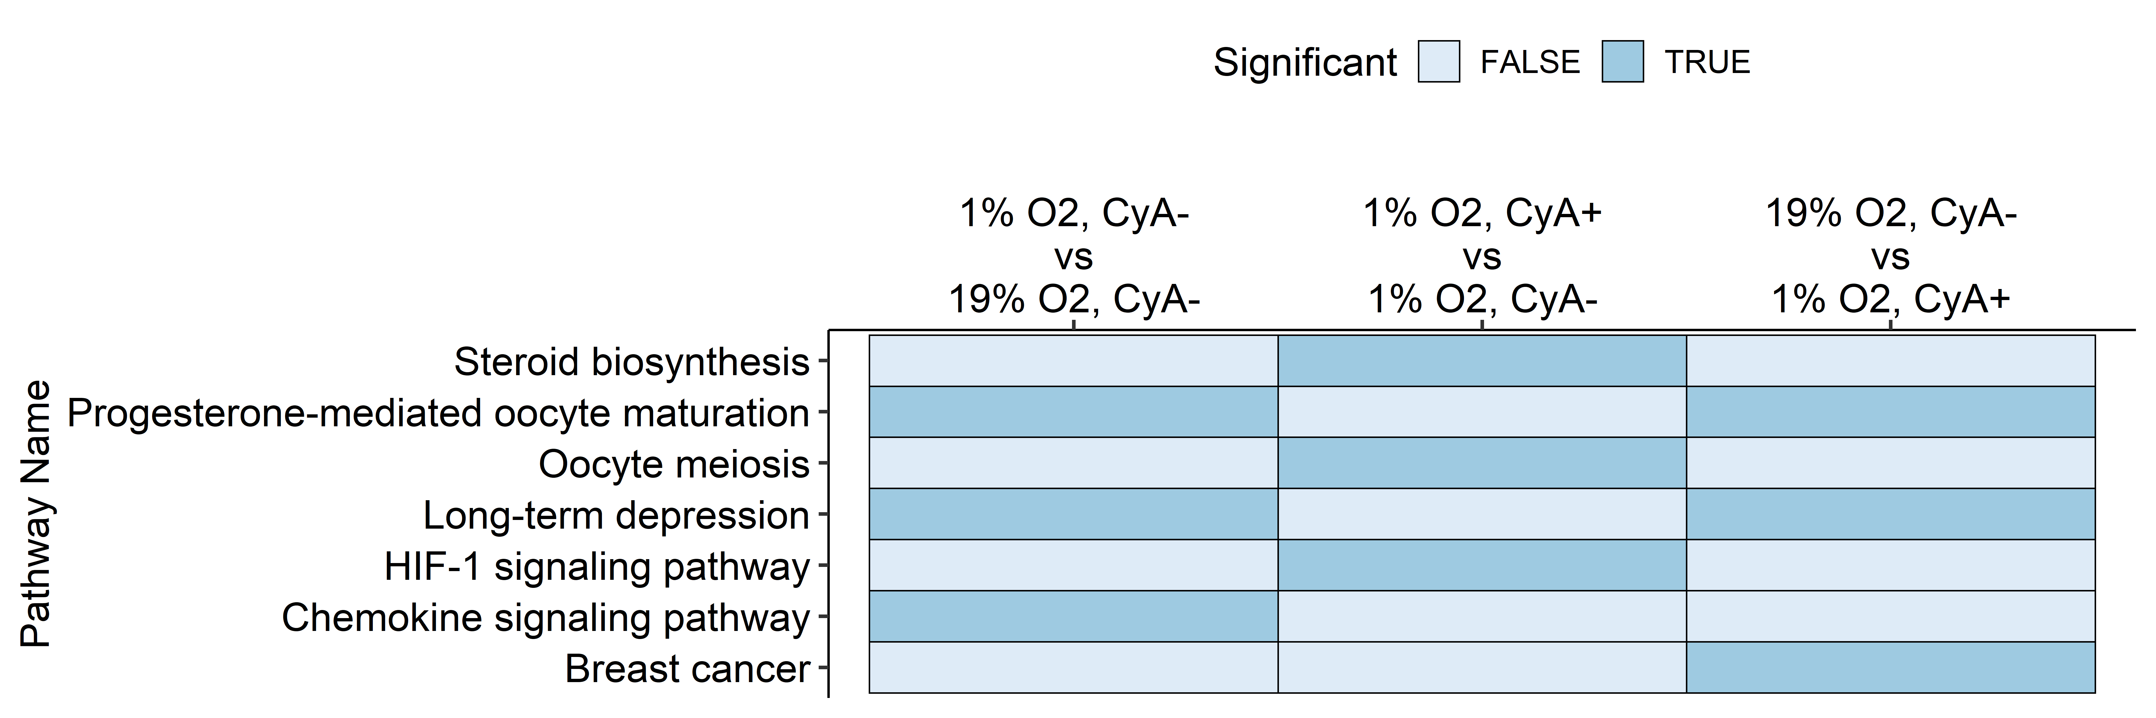
A
B
Color key:
C
Contrasts
Figure 2: mBONITA identifies mechanisms of hypoxia-mediated chemotaxis from a multi-omics dataset from RAMOS B cells grown under three conditions (A) 1505 genes were profiled in all three omics datasets (median log2-abundance > 0) (B) The multi-omics datasets showed low inter-dataset correlations. Distinct experimental conditions are indicated by colors and shapes as shown in the legend. (C ) KEGG pathways identified by mBONITA as significantly dyresgulated in the three contrasts. Pathways are defined as differentially regulated if the Benjamini-Hochberg corrected p-value < 0.05.

Slide 8
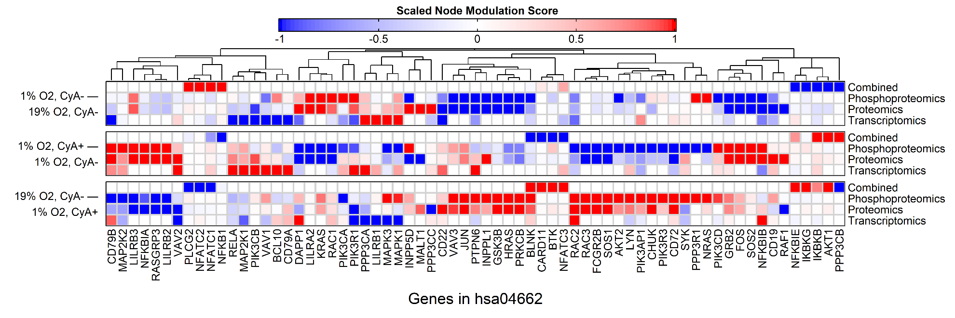
Figure 3: Pathway-based prioritization of genes in a signaling network with mBONITA. Node modulation score: show a case study of a LSP1/HIF1A-centric signaling network (TO BE DONE). (A) Network figure (B) Heatmap of node modulation scores. This is a placeholder/draft figure showing node modulation scores for each dataset/contrast combination for the B cell receptor signaling network. NB – this is just IS * RA, need to multiply by std.dev as well

Slide 9
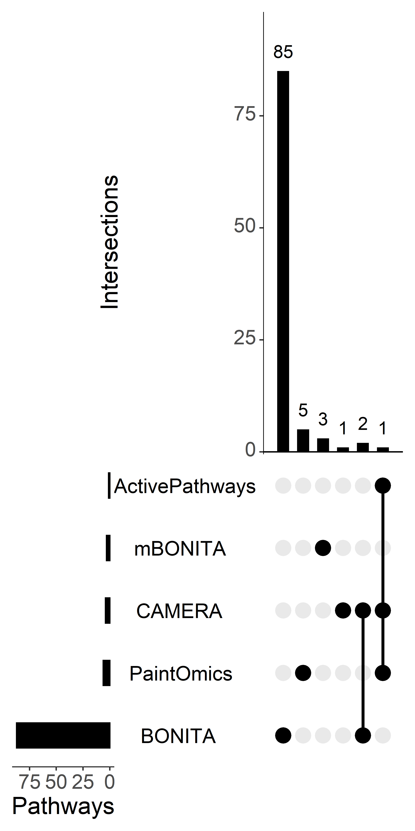
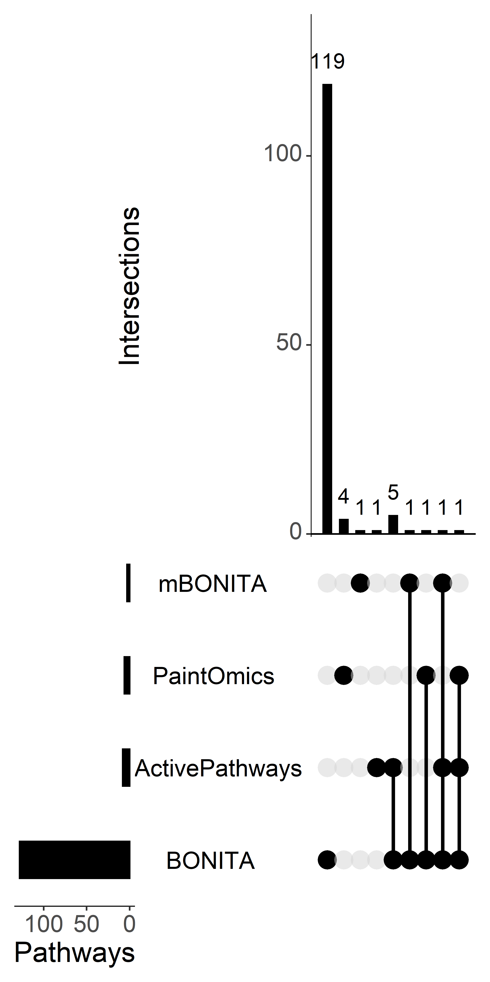
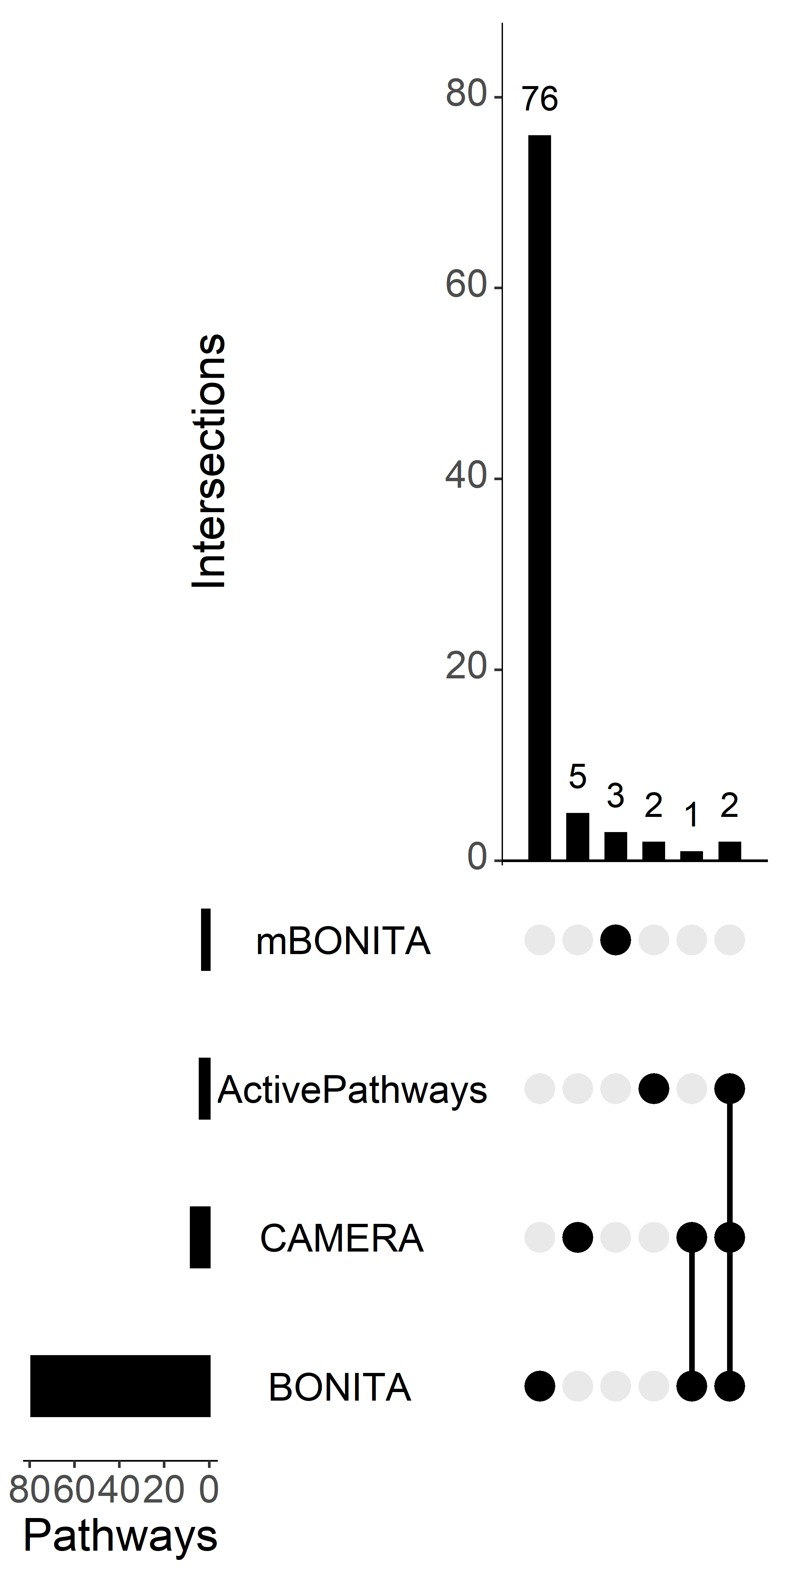
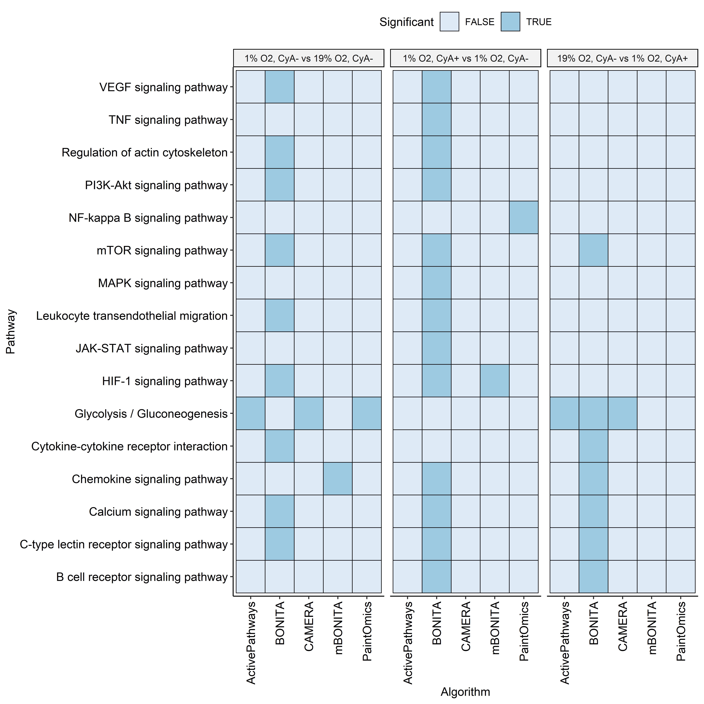
Figure 4: Benchmarking of mBONITA. Numbers of differentially regulated KEGG pathways identified from combination multi-omics data by tested methods in three contrasts (A) 19%O2,CyA- vs 1%O2,CyA- (B) 1%O2,CyA+ vs 1%O2,CyA- (C ) 19%O2,CyA- vs 1%O2,CyA+ (D). Pathways known to be involved in the hypoxia-mediated response to CyA, Only pathways identified as significant from a combined dataset by at least one method are shown. Pathways are defined as differentially regulated if the Benjamini-Hochberg corrected p-value < 0.05.
A
B
C
D

Slide 10
Supplementary figures and tables

Slide 11
Data type | Oxygen | CyA | CXCL12
Proteomics | 19% | "-" | "-"
 | 1% | "-" | "-"
 | 1% | "+" | "-"
Transcriptomics | 19% | "-" | "-"
 | 19% | "+" | "-"
 | 1% | "-" | "-"
 | 1% | "+" | "-"
Phosphoproteomics | 19% | "+" | "+"
 | 19% | "-" | "+"
 | 19% | "+" | "-"
 | 19% | "-" | "-"
 | 1% | "+" | "+"
 | 1% | "-" | "+"
 | 1% | "+" | "-"
 | 1% | "-" | "-"
Supplementary Table 1 Experimental conditions in the three datasets from RAMOS B cells. Conditions that are in all datasets are highlighted in red.

Slide 12
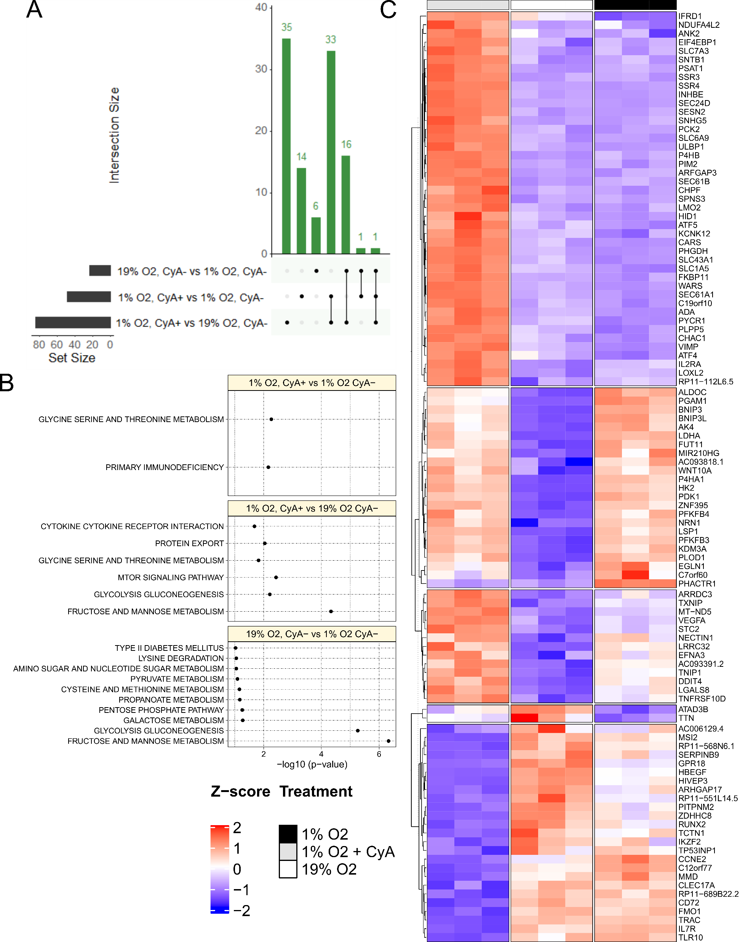
Suppplementary Figure 1: Transcriptomics analysis of RAMOS B cells grown under three conditions. (A) Numbers of differentially expressed genes identified by DESeq2 in all three contrasts (absolute log2-fold change > 0.5 and Bonferroni-adjusted p-value < 0.05) (B) z-scored RPM values of DE genes identified in all/any contrast. Experimental conditions are indicated by colors as shown in the legend. (C ) Over-representation analysis of DE genes in all three contrasts (unadjusted p-value < 0.05). Complete tables of DE genes and over-represented pathways may be found in the Supplementary Data.

Slide 13
Supplementary Table 2: KEGG Pathways involved in the HIF1A-mediated response of B cells to hypoxia and CyA
 | KEGG Pathway | KEGG Code
1 | MAPK signaling | hsa04010
2 | Chemokine signaling | hsa04062
3 | NF-kappa B signaling | hsa04064
4 | HIF-1 signaling | hsa04066
5 | mTOR signaling | hsa04150
6 | PI3K-Akt signaling | hsa04151
7 | VEGF signaling | hsa04370
8 | Cell adhesion | hsa04514
9 | C-type lectin receptor signaling | hsa04625
10 | JAK-STAT signaling | hsa04630
11 | TNF signaling | hsa04668
12 | Leukocyte transendothelial migration | hsa04670
13 | Regulation of actin cytoskeleton | hsa04810

Slide 14
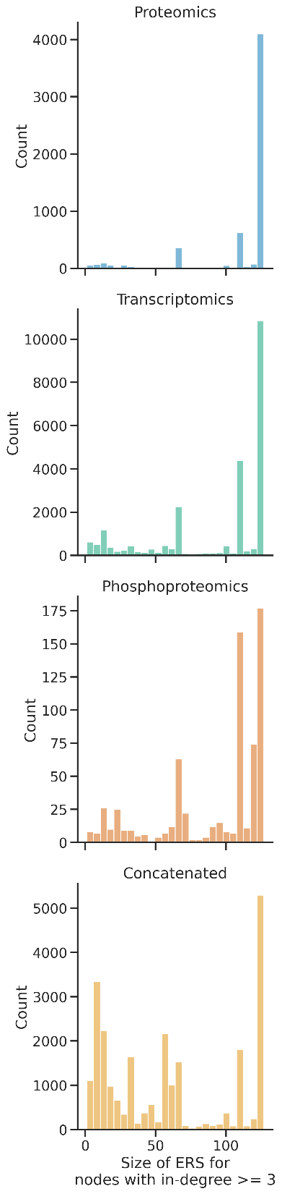
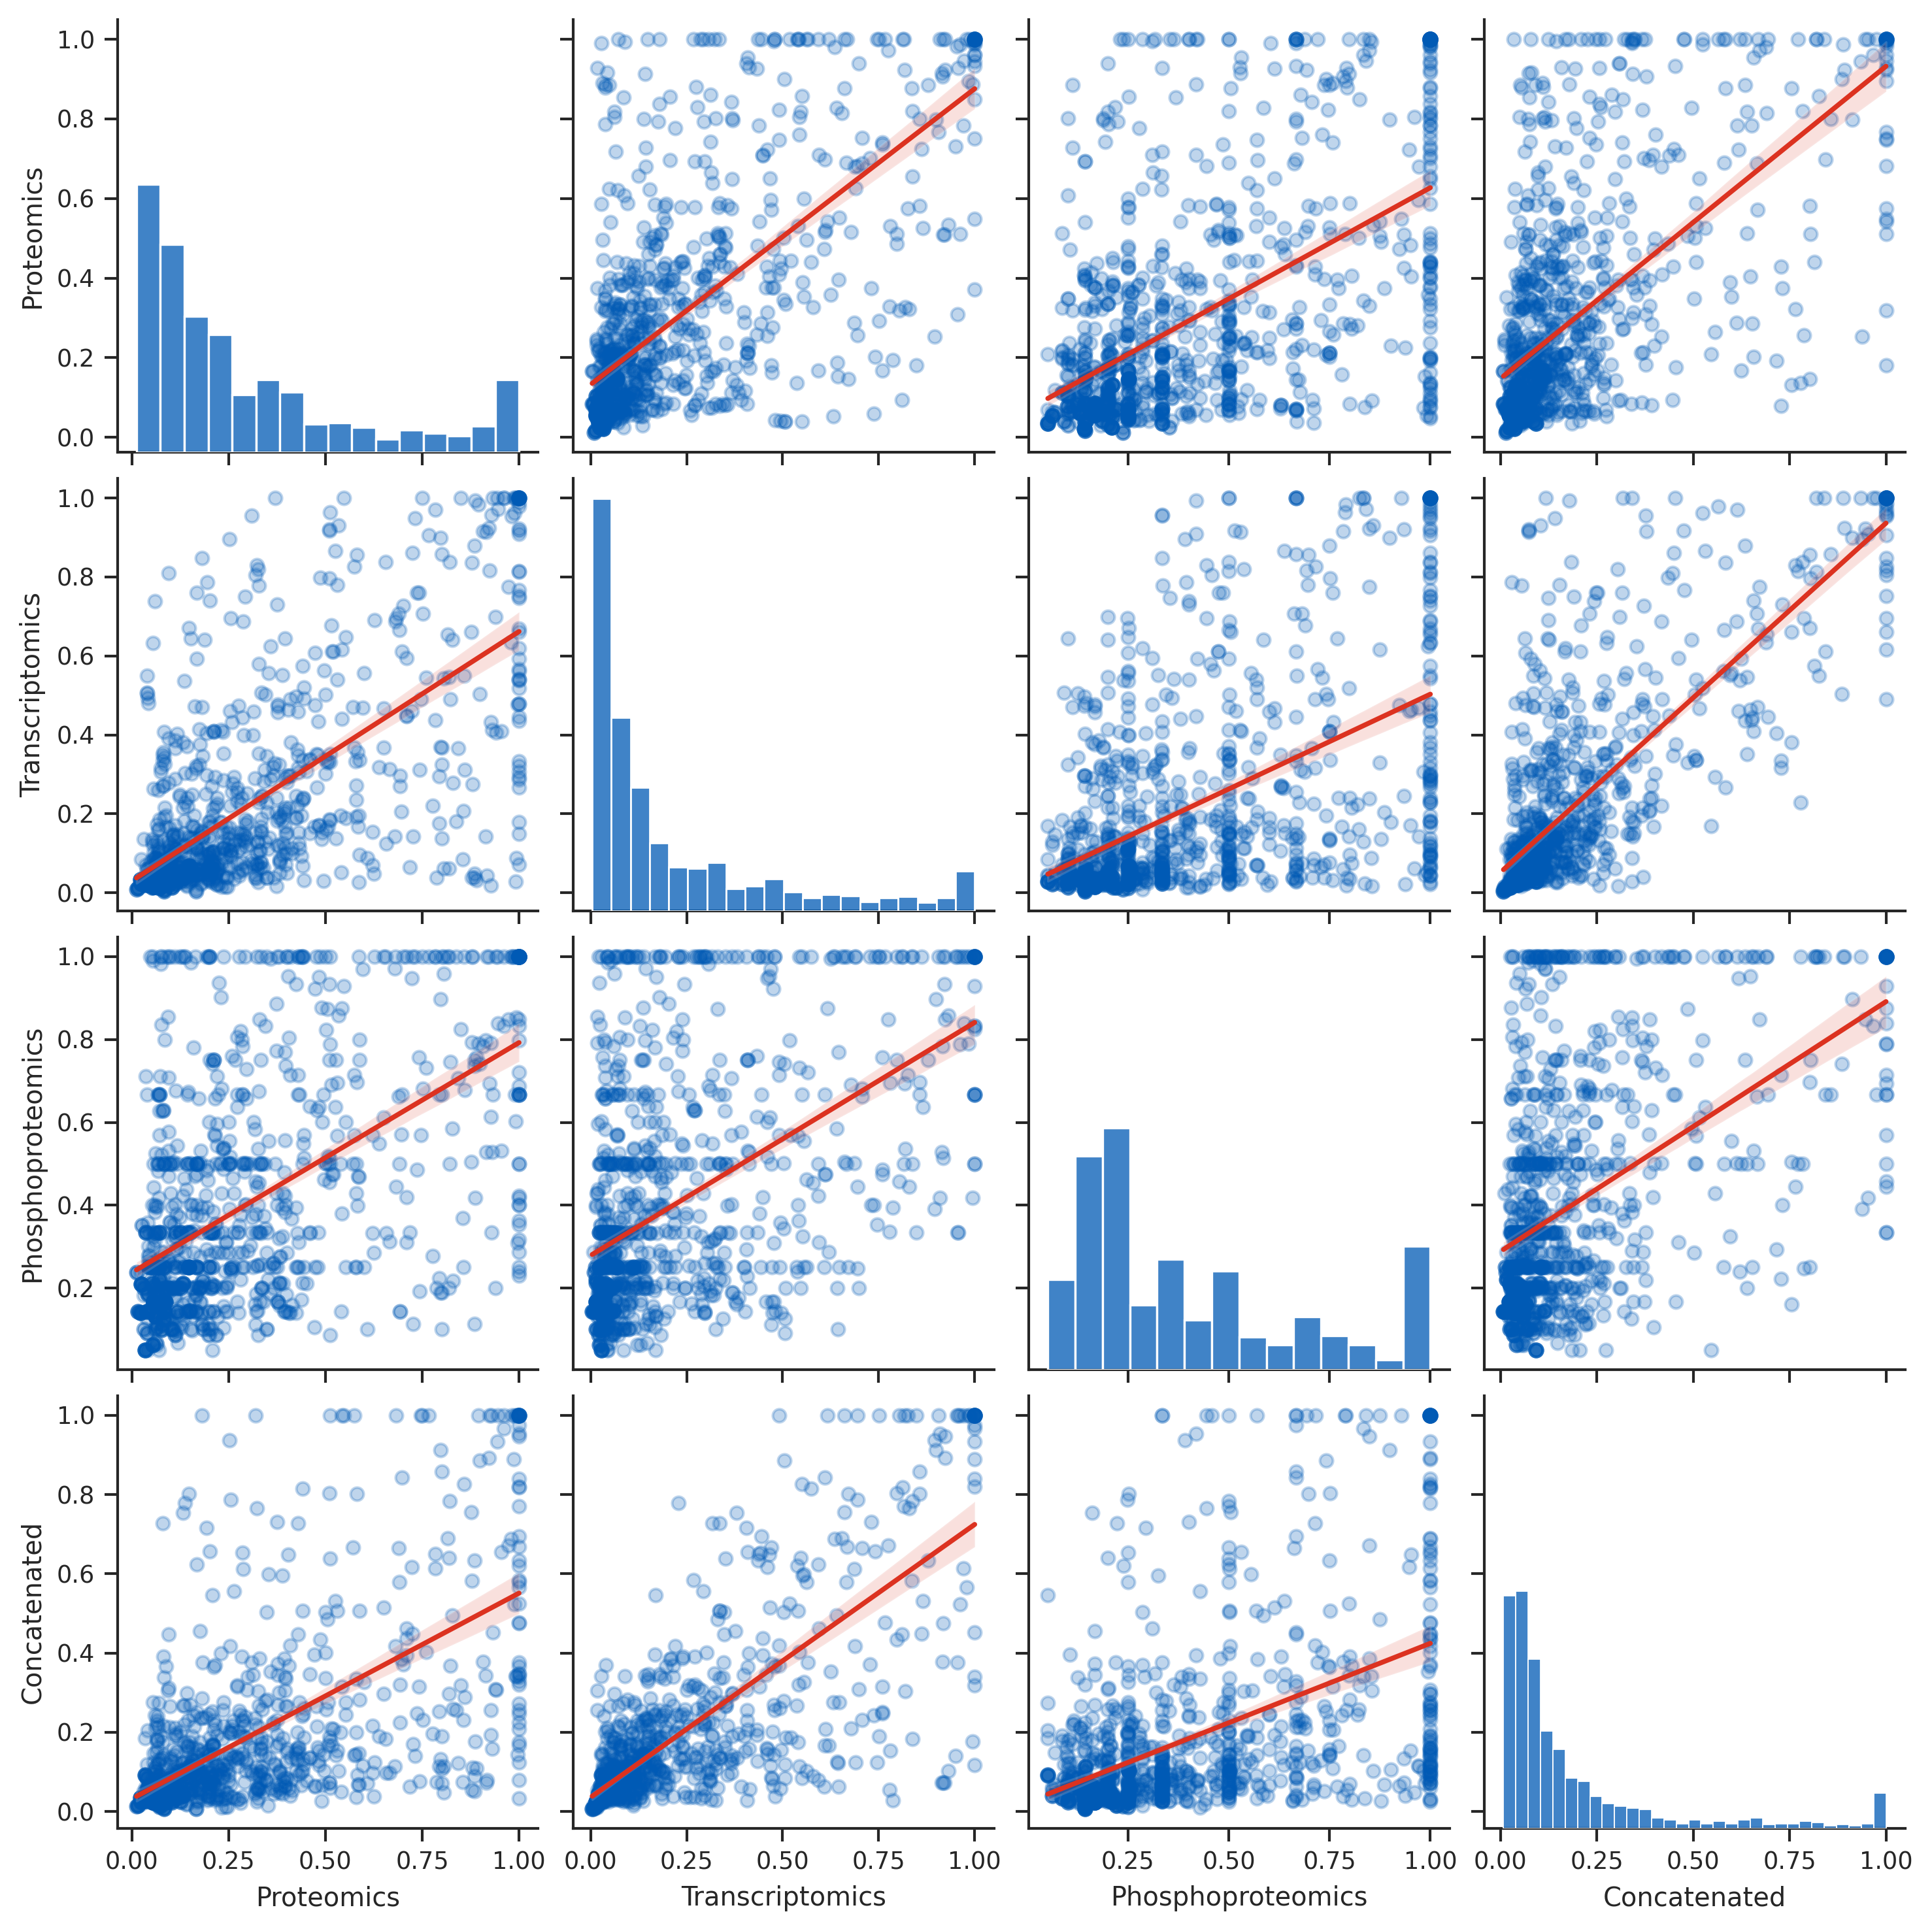
Supplementary Figure 2: Rule inference from all three datasets – (A) Rule set sizes, (B) Importance scores (Spearman correlations between 0.5 and 0.8, p << 0.01). See Supplementary Table 3 for all correlation coefficients.
A
B

Slide 15
Supplementary Table 3: Spearman correlation between importance scores
Dataset | Concatenated | Phosphoproteomics | Proteomics | Transcriptomics
Concatenated | 1 | 0.494465 | 0.661879 | 0.796354
Phosphoproteomics | 0.494465 | 1 | 0.539542 | 0.532783
Proteomics | 0.661879 | 0.539542 | 1 | 0.707195
Transcriptomics | 0.796354 | 0.532783 | 0.707195 | 1

Slide 16
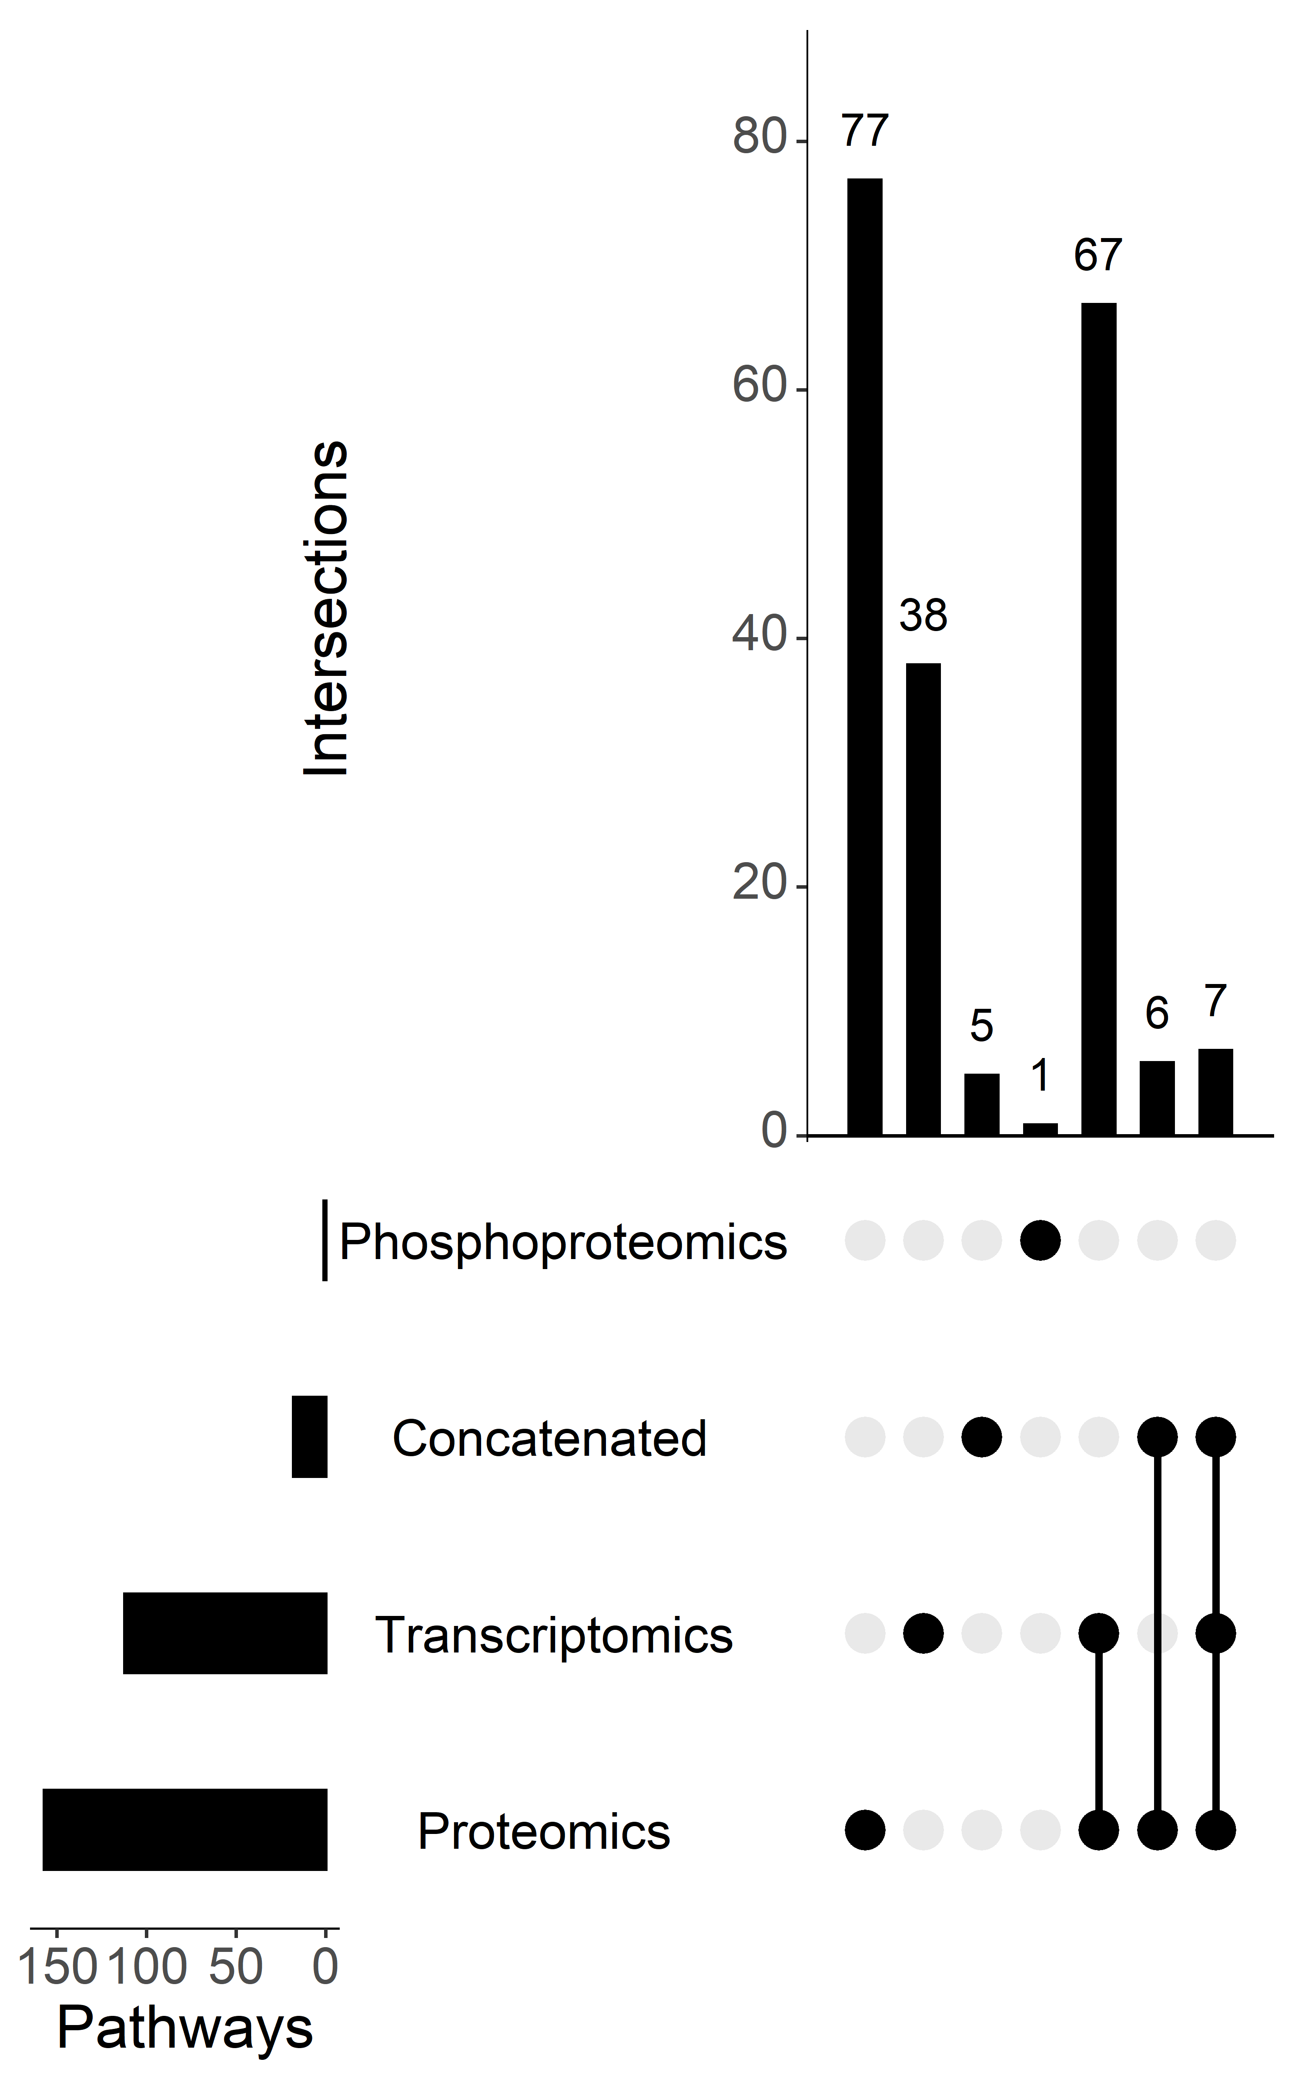
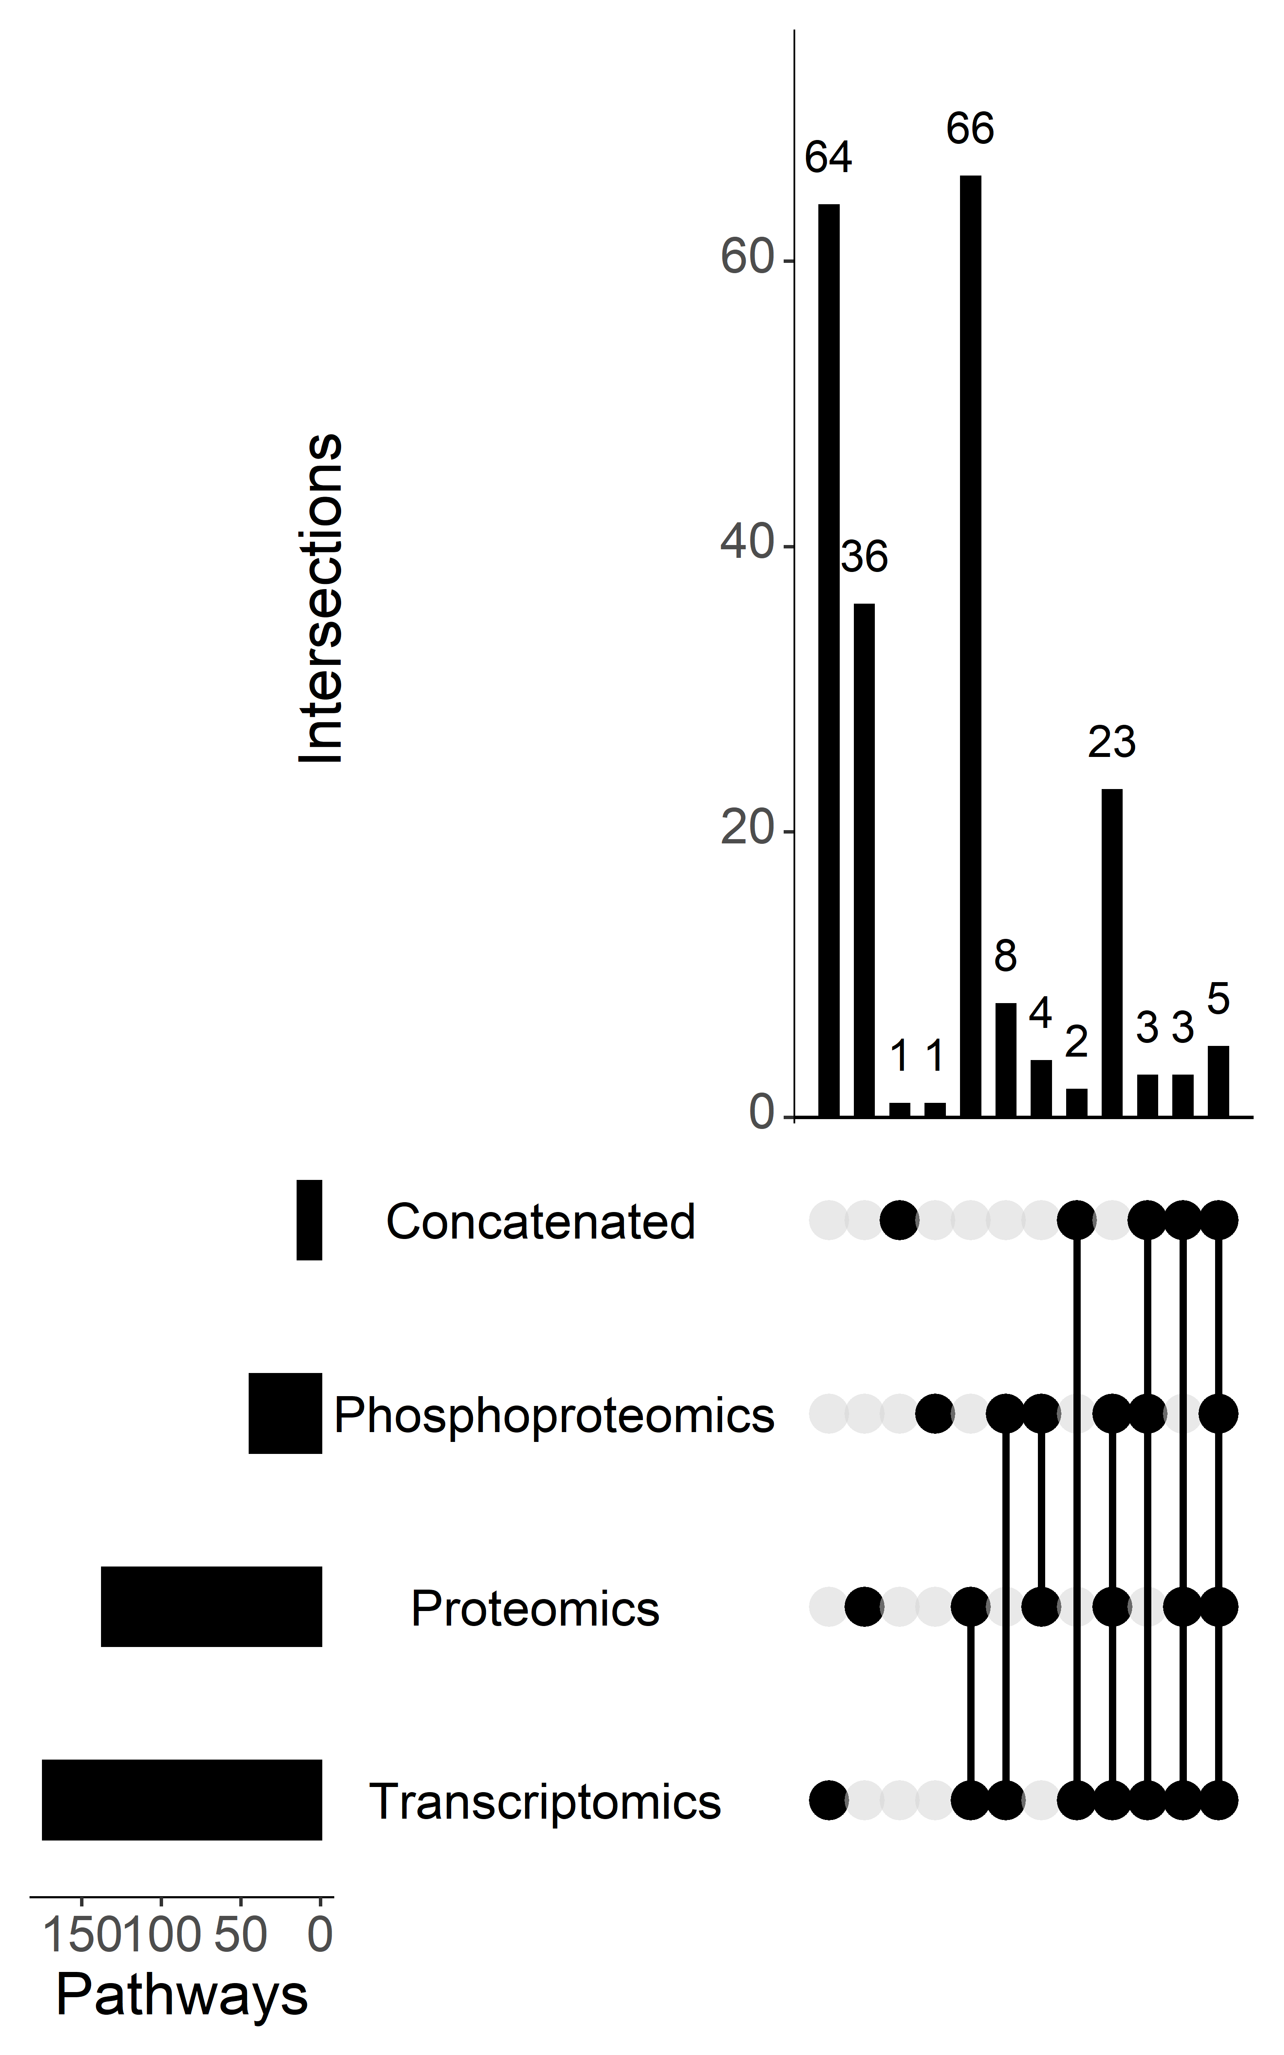
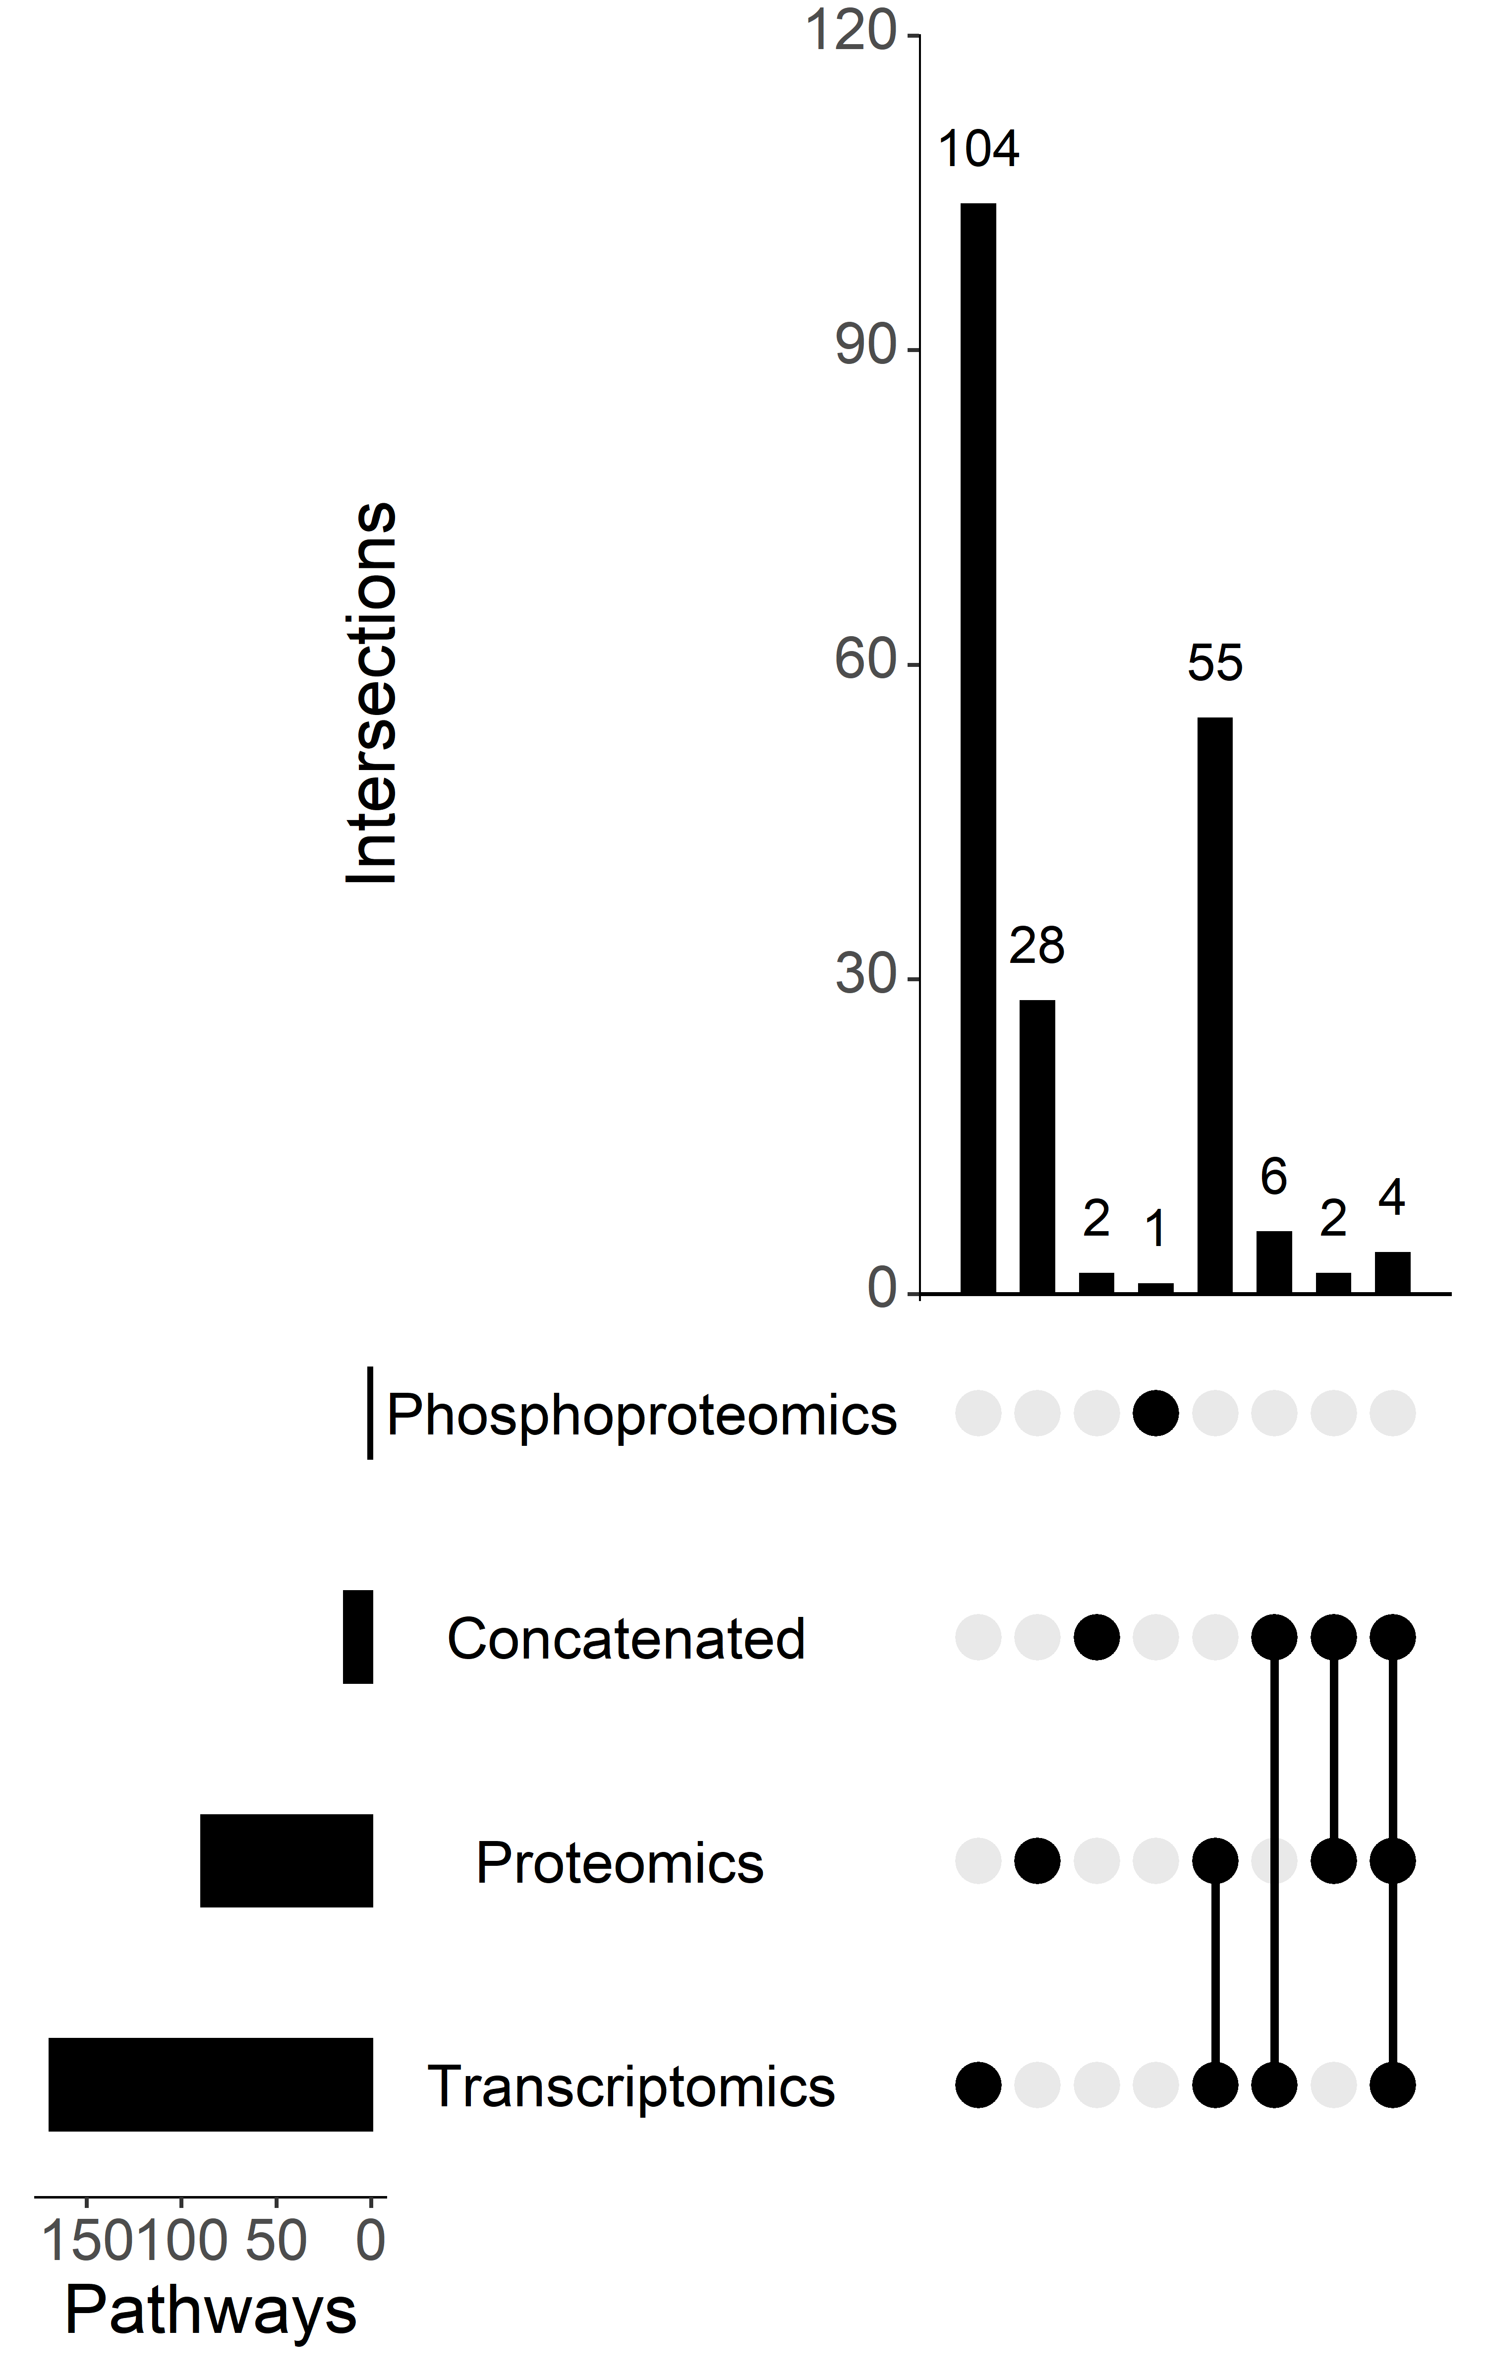
A
B
C
Supplementary Figure 3: Comparison of mBONITA-PA to BONITA-PA Numbers of differentially regulated pathways identified from combination multi-omics data by mBONITA in three contrasts (A) 19%O2,CyA- vs 1%O2,CyA- (B) 1%O2,CyA+ vs 1%O2,CyA- (C ) 19%O2,CyA- vs 1%O2,CyA+. Pathways are defined as differentially regulated if the Benjamini-Hochberg corrected p-value < 0.05.

Slide 17
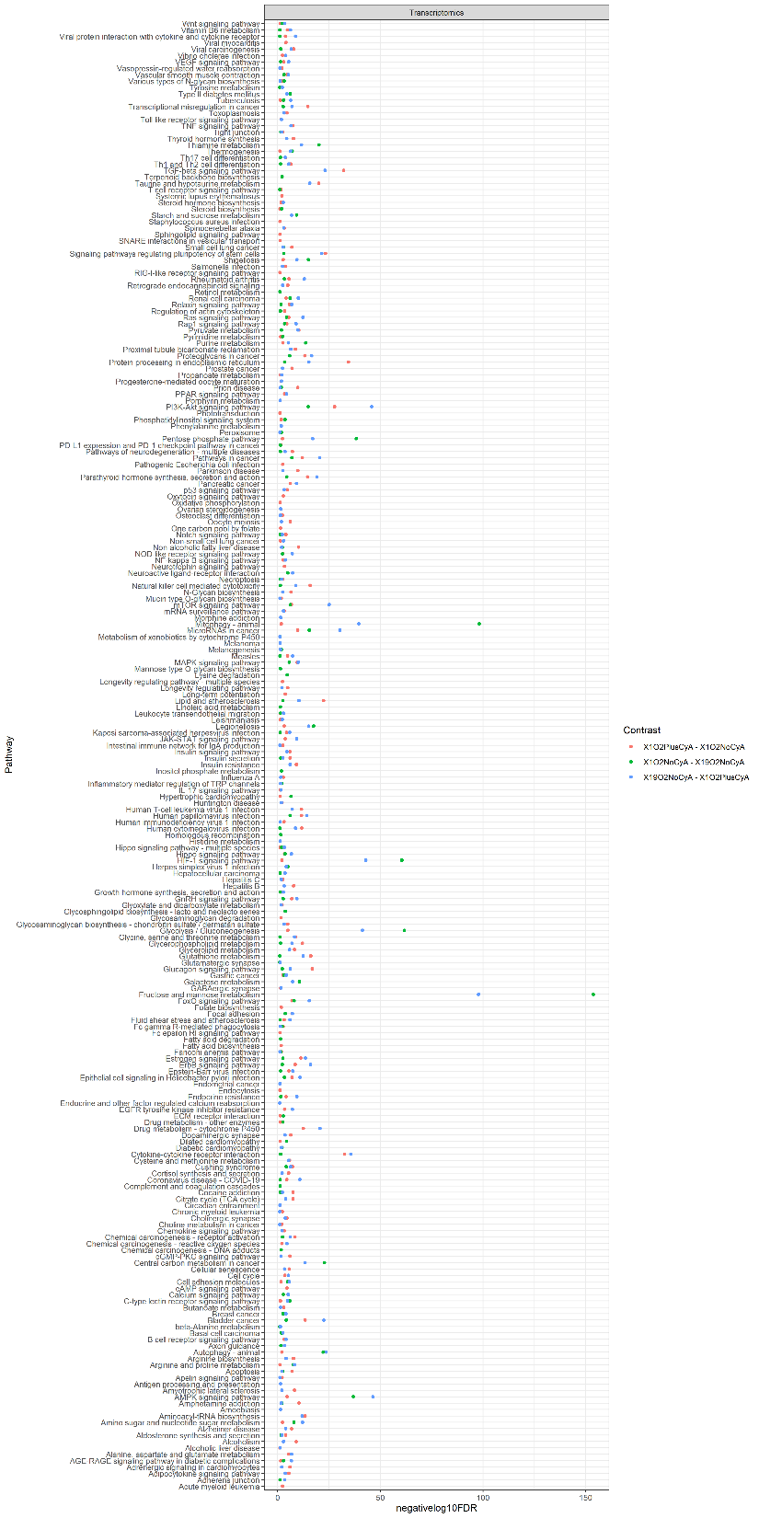
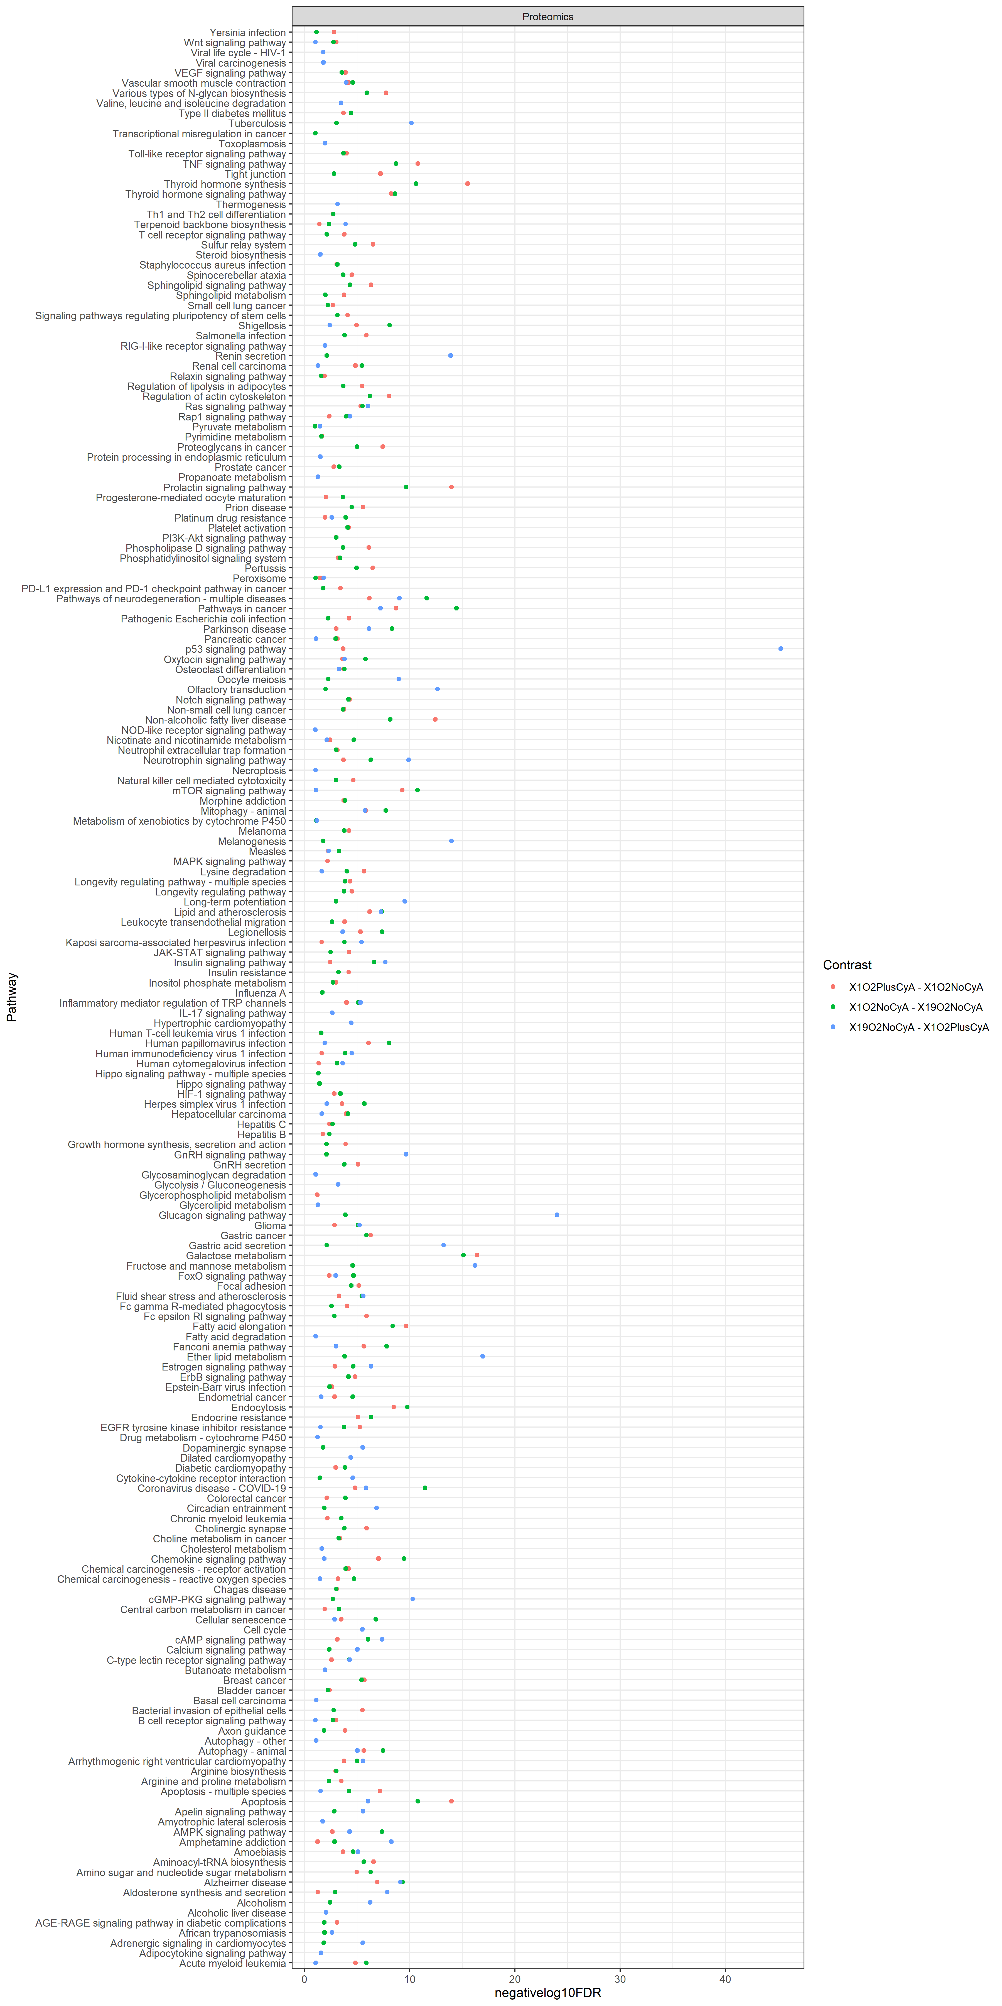
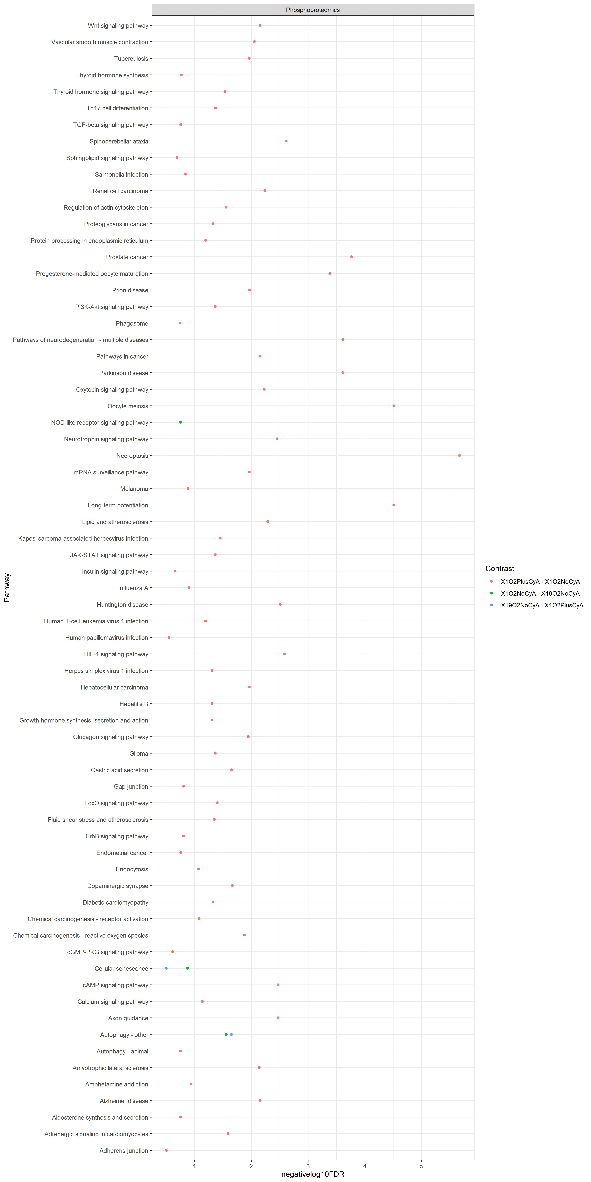
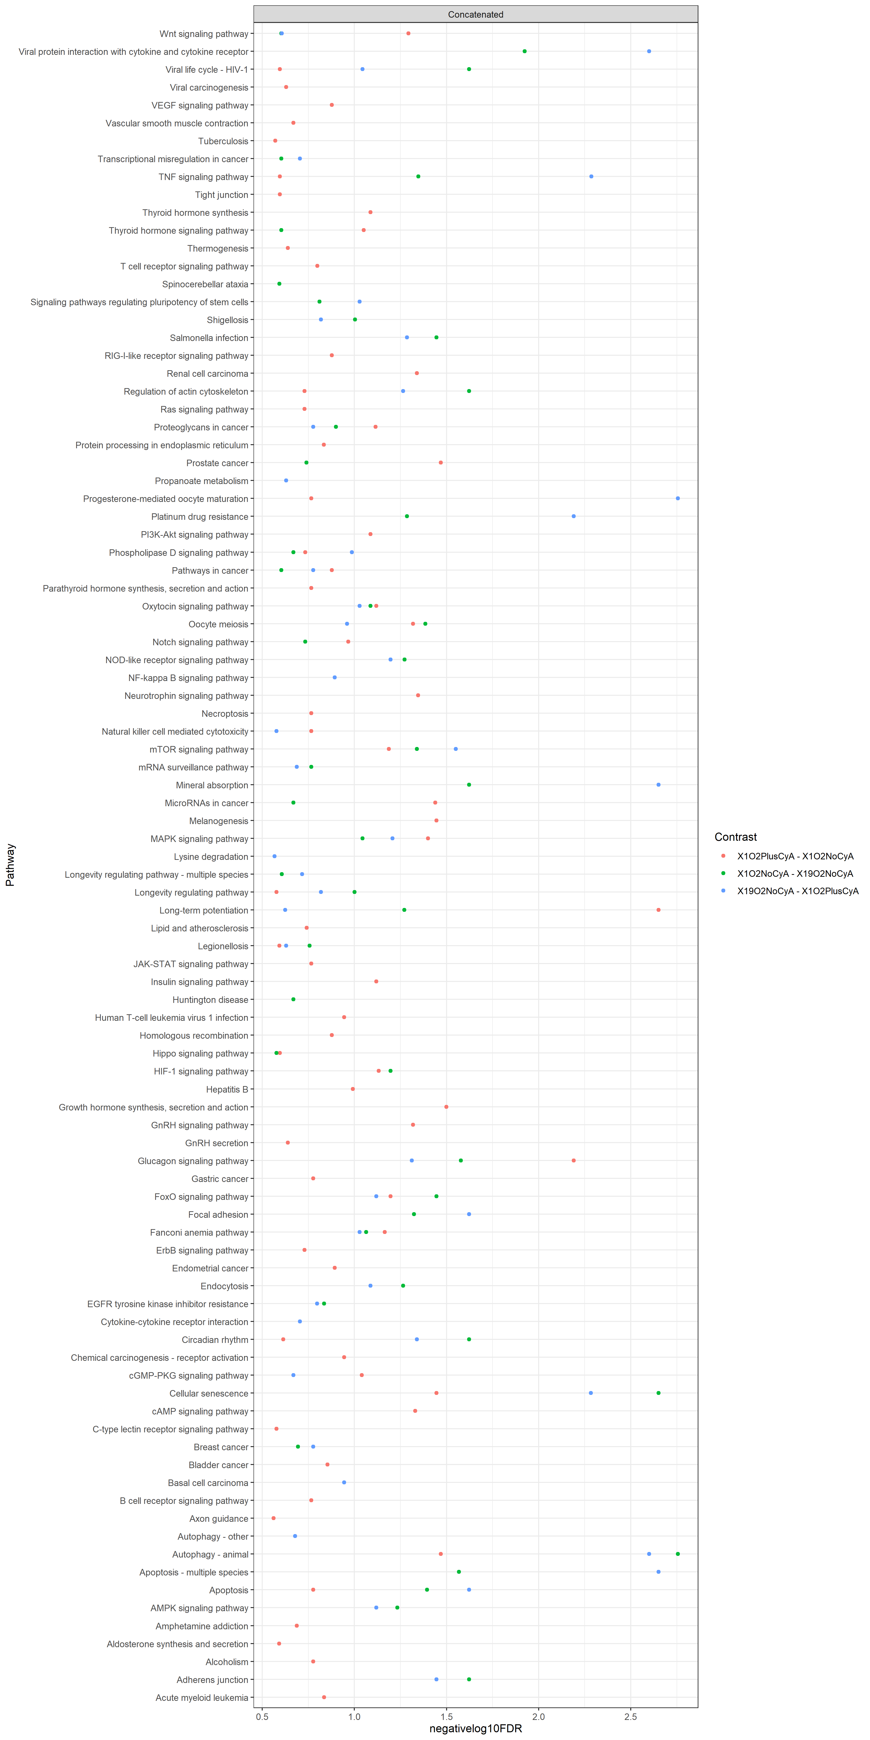
Supplementary Figure 4: Pathway analysis with Bonita and mBonita. All p-values are Bonferroni-corrected and are < 0.01. The top 10 pathways with the lowest p-values are shown. A complete table of significantly dysregulated pathways may be found in the Supplementary Data (A) Transcriptomics (B) Proteomics (C ) Phosphoproteomics (D ) mBonita
Notes:
We also used BONITA-PA to identify pathways that were dysregulated between pairs of conditions from the three datasets. Figure 2C shows a representative set of results comparing B cells grown at 1% oxygen with and without CyA (if PA results are different). Different pathways are identified as being dysregulated in different datasets (if PA results are similar). The similarity between the pathways identified as being dysregulated shows that overall networks that are dysregulated can be identified by using different omics datasets (Conclusions: Network picture more similar than gene level comparisons or enrichr comparisons).

Slide 18
Supplementary File 1: mBONITA-PA results Excel workbook - pvalues_concatenated_20220816
Supplementary File 2: PaintOmics results (paintomics_allResults.csv)
Supplementary File 3: leapR results (leapR_allResults.csv)
Supplementary File 4: CAMERA results (camera_allResults.csv)
Supplementary File 5: ActivePathways results (activePathways_allResults.csv)
Supplementary File 6: BONITA results

Slide 19
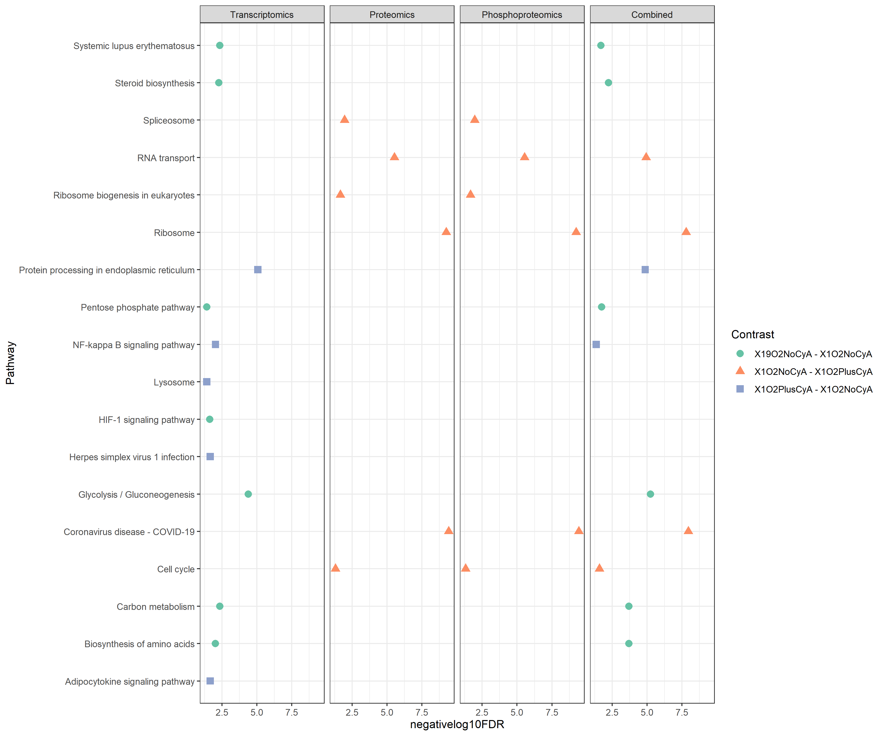
Supplementary Figure 5: paintOMICS results

Slide 20
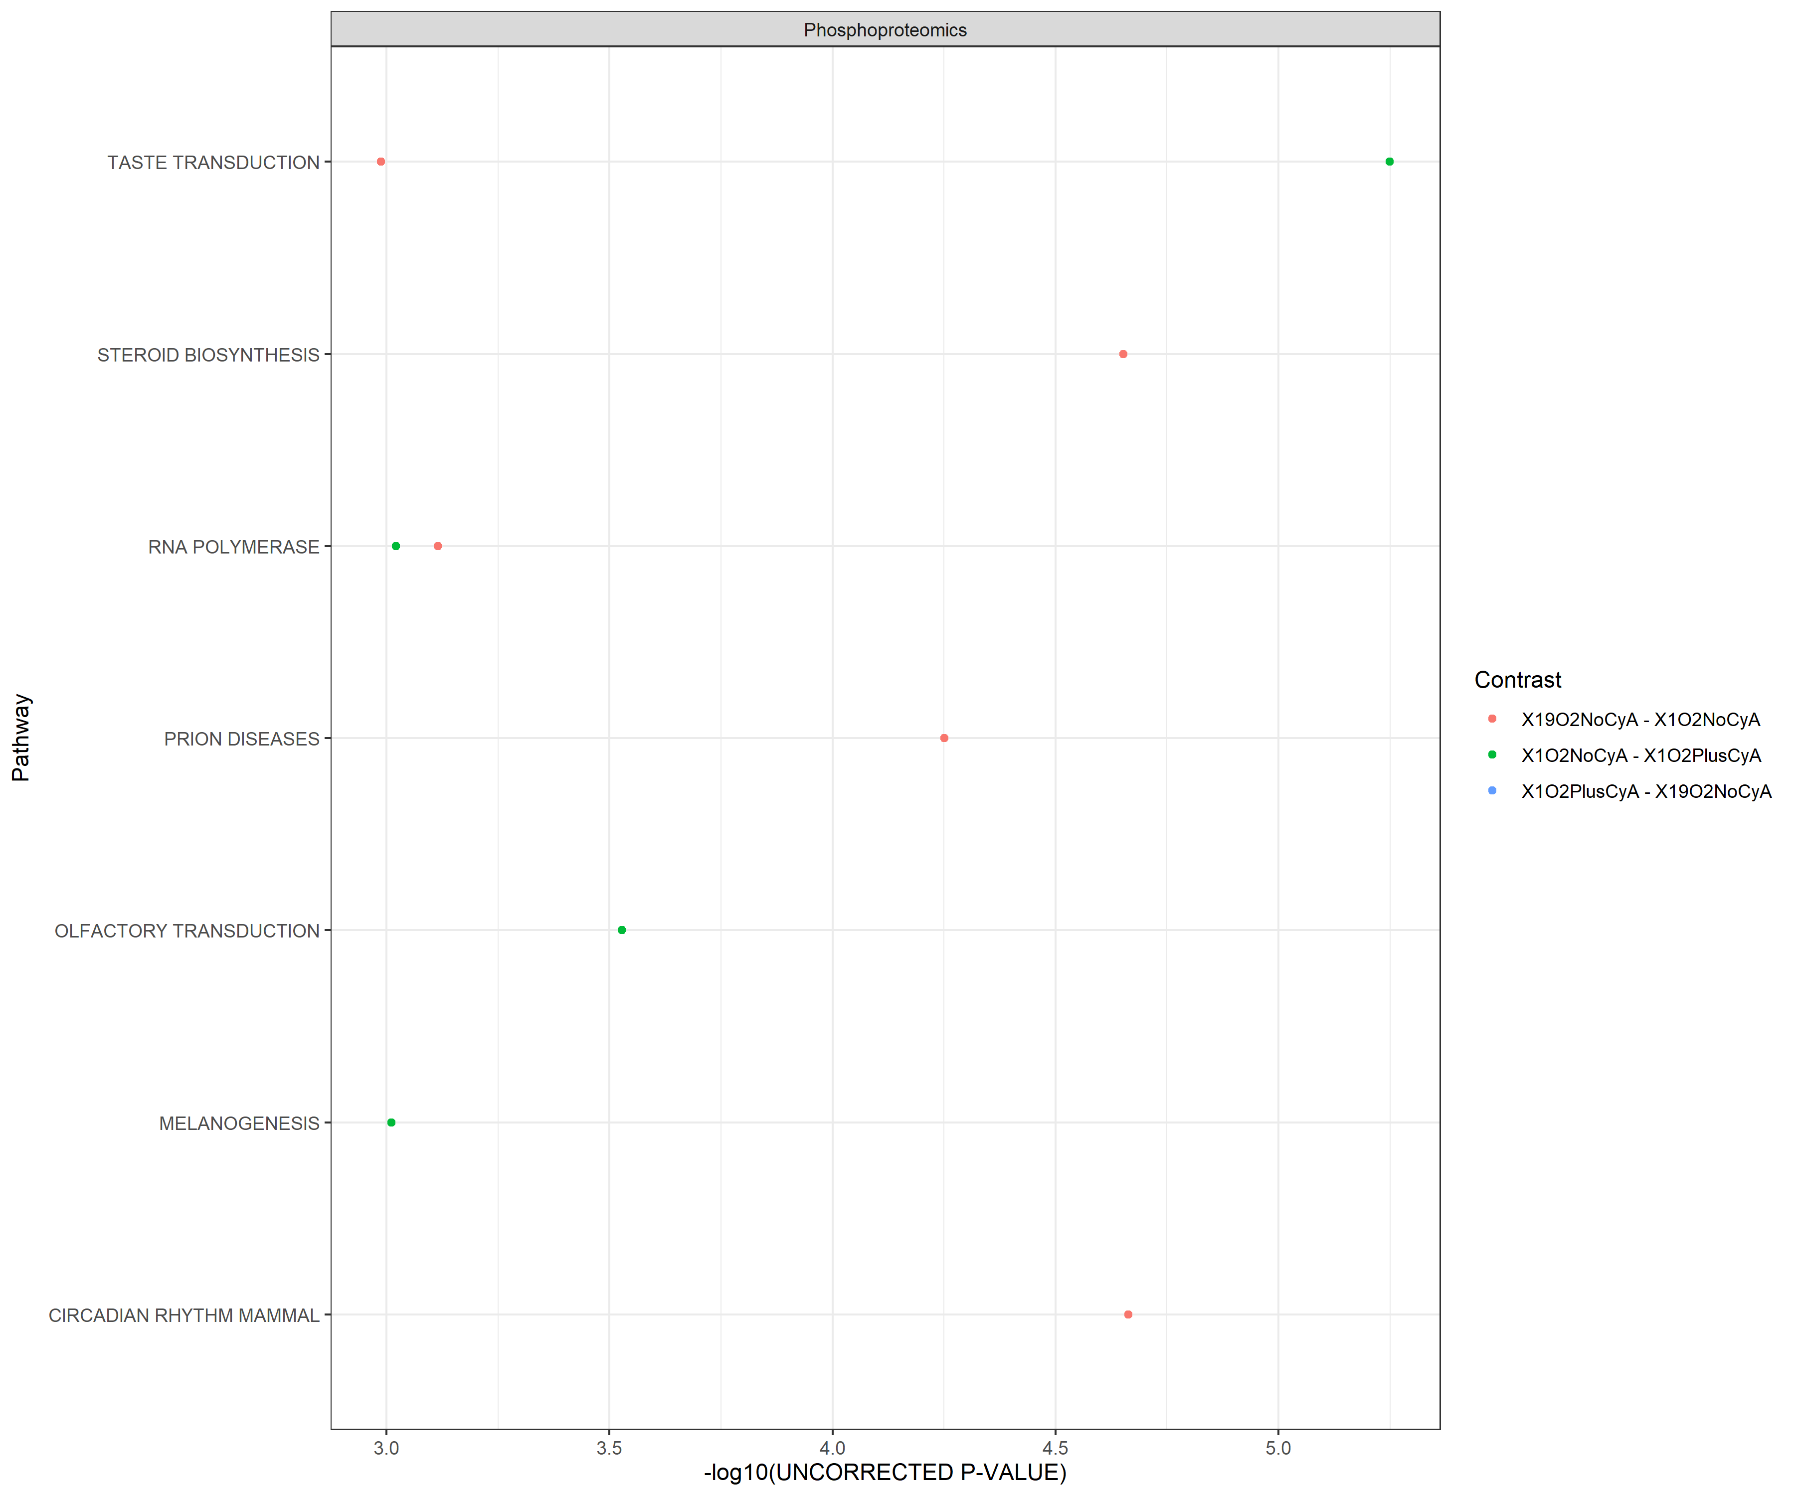
Supplementary Figure 6: leapR results

Slide 21
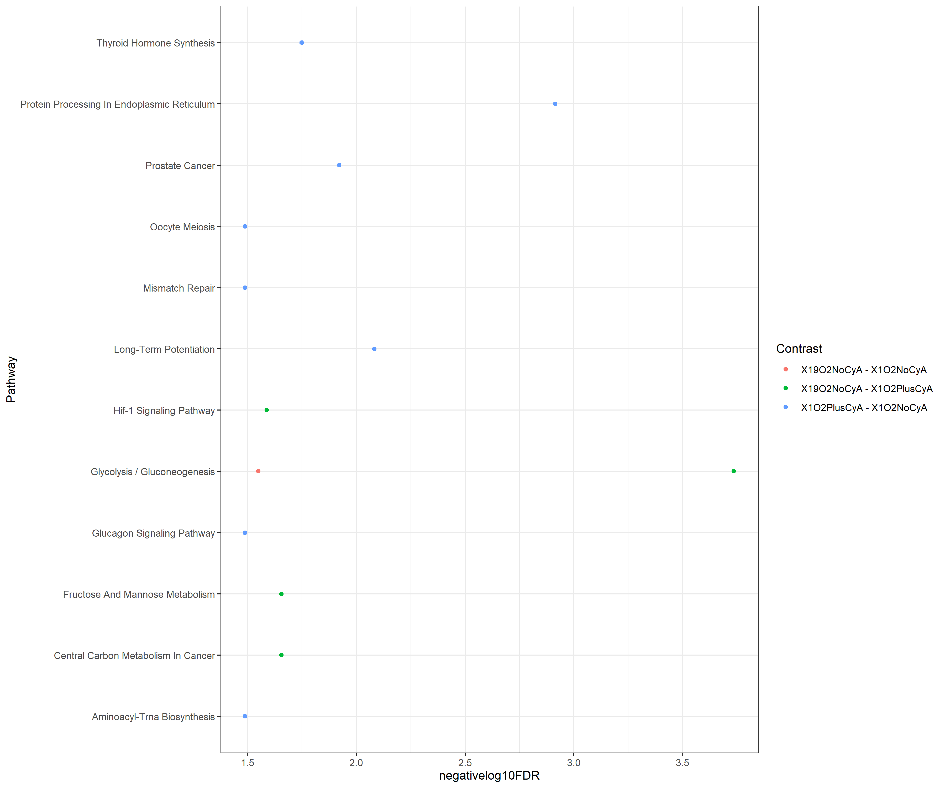
Supplementary Figure 7: ActivePathways

Slide 22
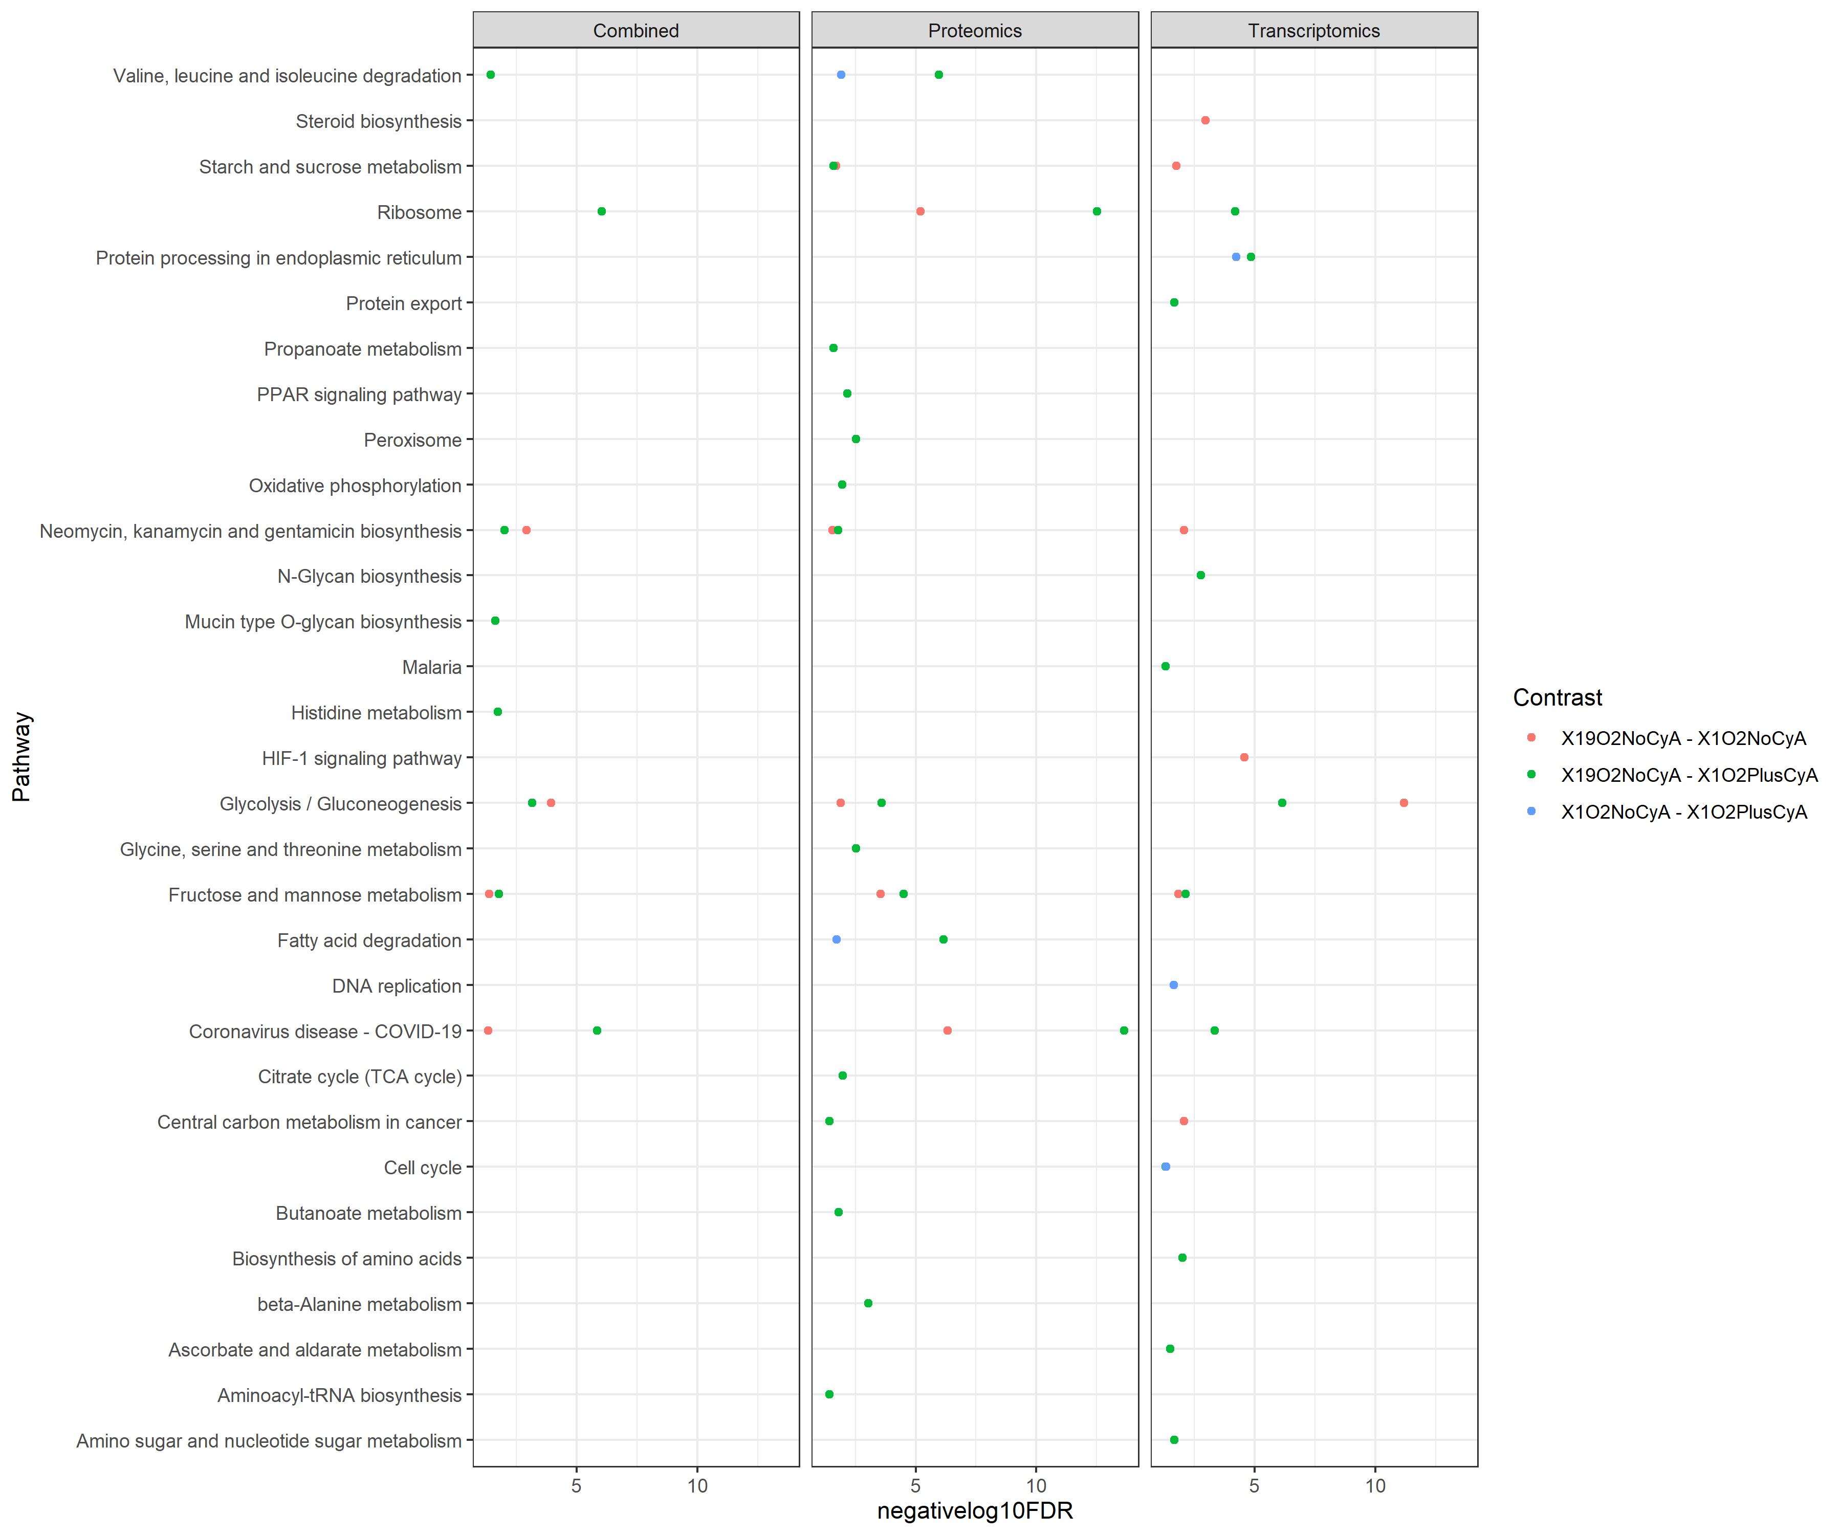
Supplementary Figure 8: CAMERA + Fisher results

Slide 23
Drafts of figures

Slide 24
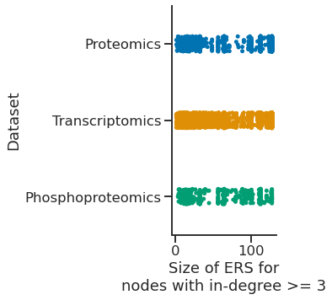

Slide 25
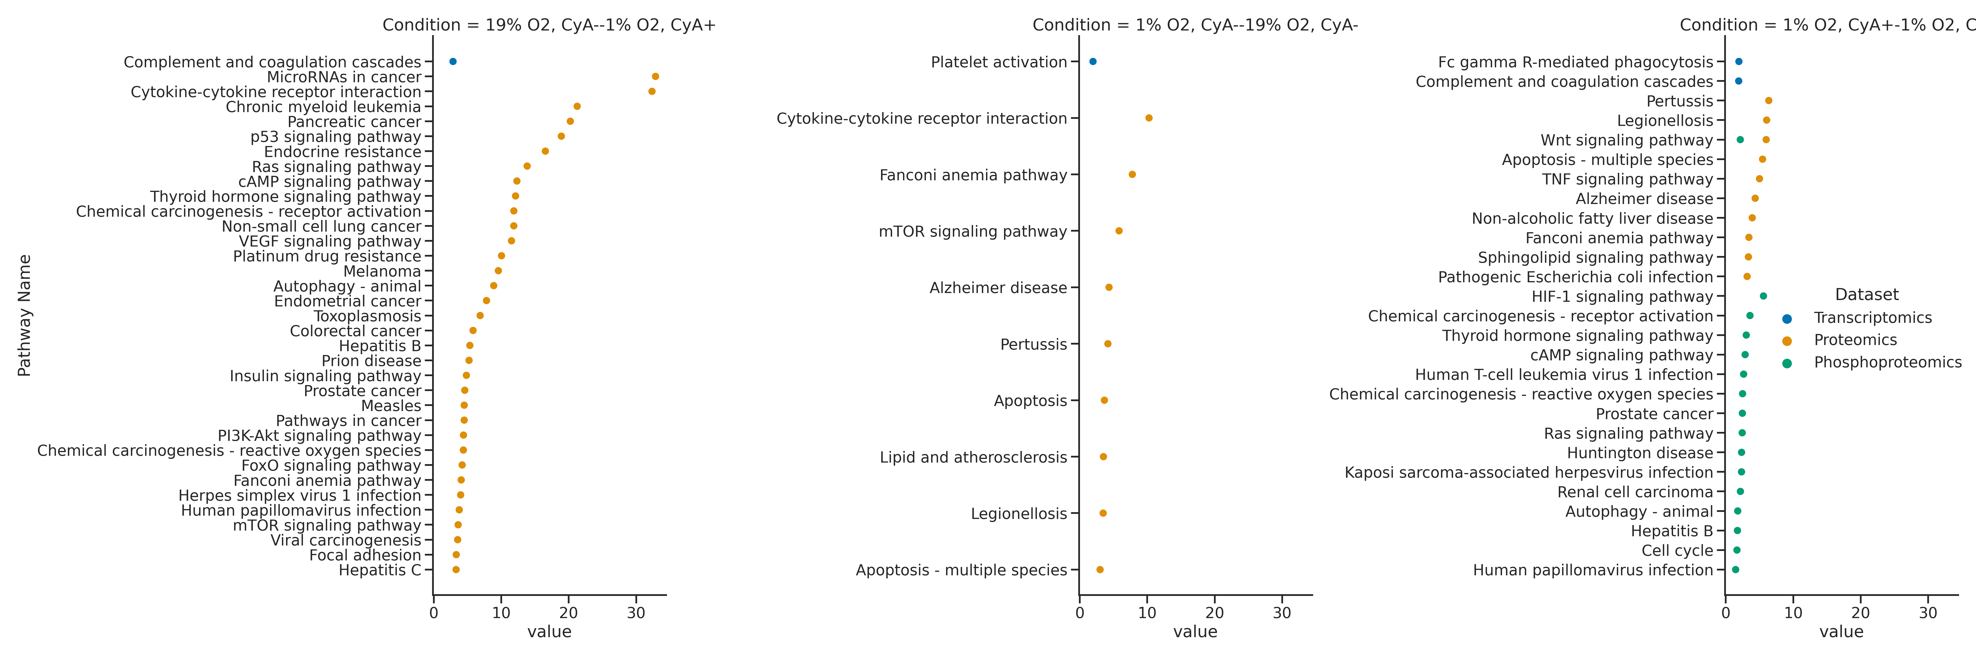
Alternate for Figure 5: Pathway analysis with Bonita (a) Proteomics (Bonferonni-adjusted p value < 0.001) (b) Transcriptomics (unadjusted p value < 0.05) (c) Phosphoproteomics (unadjusted p value < 0.05). (d) TO BE ADDED. Multiomics network. Contrasts are color-coded as shown in the legend.

Slide 26
Collect multi-omics data
Identify a consensus rule set
Identify dysregulated pathways
Proteomics
Node modulation scores
Phosphoproteomics
Consensus set of logic rules
Dysregulated subnetworks
Transcriptomics
Ranked dysregulated pathways

Slide 27
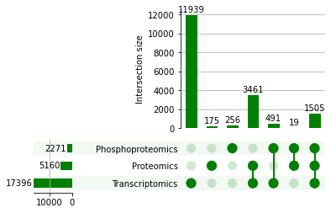
Transcriptomics
Proteomics
11939
3461
175
1505
491
19
256
Phosphoproteomics

Slide 28
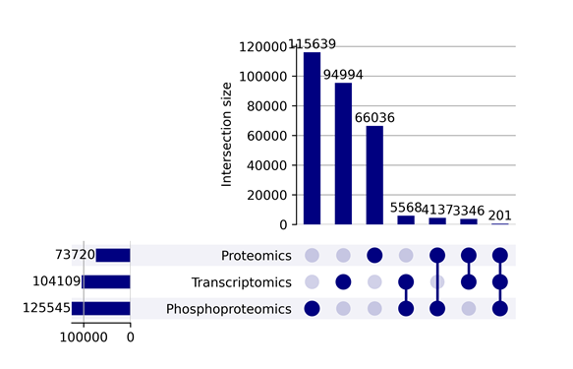
C
Figure 2, part 2: ( C) Correlation networks constructed using three multi-omics datasets showed little overlap between edges. (D) The genes involved in the overlapping edges between datasets were enriched for gene sets related to x,y,z. Enrichment analysis for other intersections are shown in the supplement.

